Slide 1
ASSESSMENT OF LEAD CONTAMINATION
IN A BIG MINING AREA IN SW SARDINIA
(MONTEVECCHIO PONENTE, ITALY)
Antonella Vecchio, Maria Gabriella Andrisani, Elisa Mariani, Maurizio Guerra,
Italian Institute for Environmental Protection and Research (ISPRA)
Alessandro Murgia, Patrizia Olla
Autonomous Region of Sardinia (RAS)
Roberto Dessì
Regional Environmental Protection Agency of Sardina (ARPAS)
Giovanni De Giudici
University of Cagliari (UniCa)

Slide 2
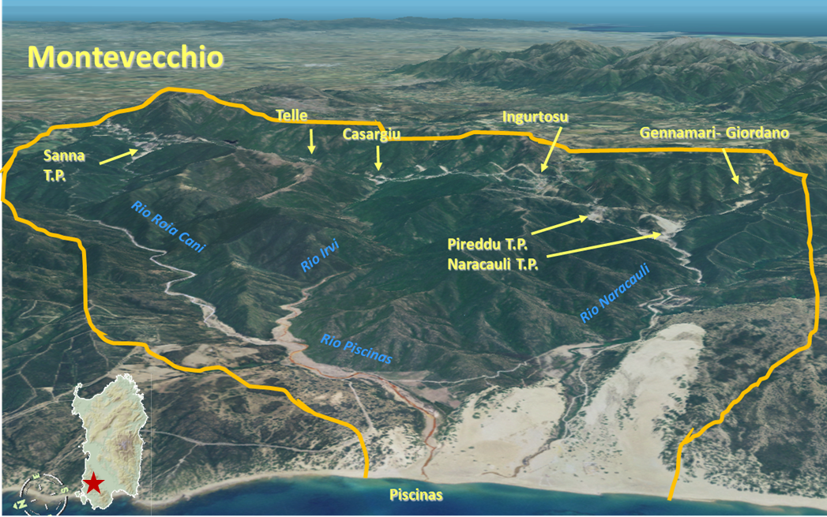
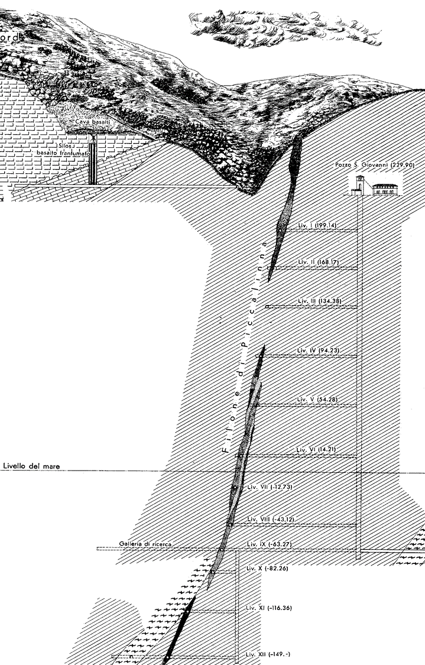
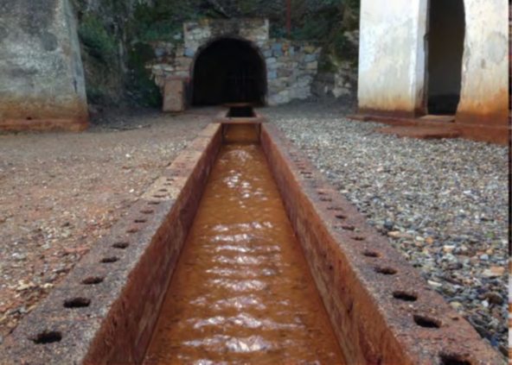
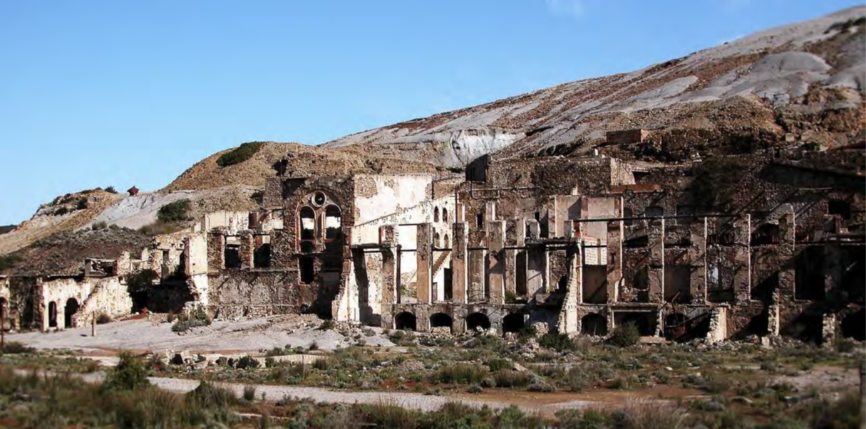
The Montevecchio Ponente mining area
The problem magnitude
Overall area: 55 km²
Hydrothermal NE-SW quartz vein system with mineralization of Pb-Zn-Cu-As sulphides in paleozoic metamorfic basement
Industrial mining activities from 1840 to 1990
More than 200 km of mining galleries deep to 500 m from surface
3 Treatment Plants (TP)
4 major tailing dams
144 mining dumps achieving more than 2 million m³ of coarse mining waste
1 million m³ of contaminated tailings dispersed downhill in creeks and beach sediments of Piscinas
Heritage from Mining activity
Heavy Metals contamination and Acid Mine Drainage in surfiace and ground water

Slide 3
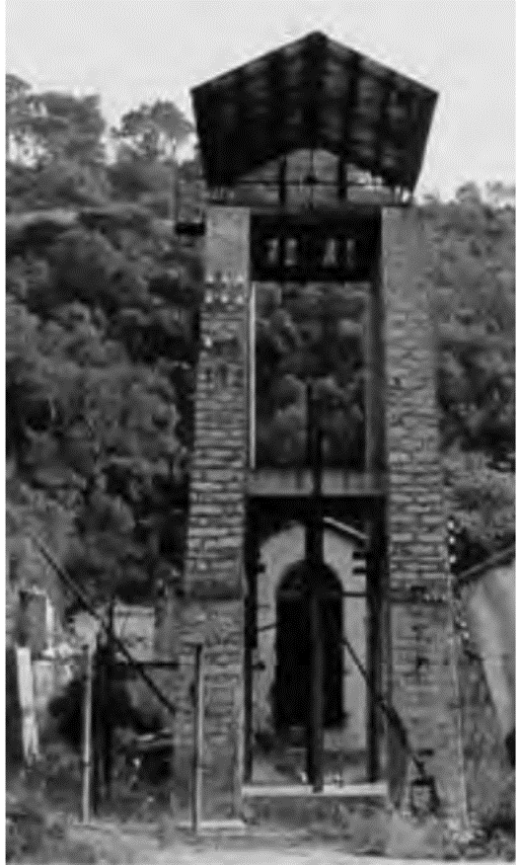
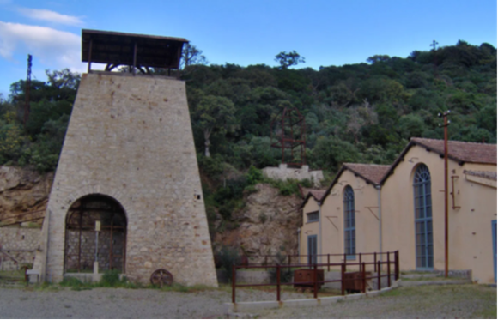
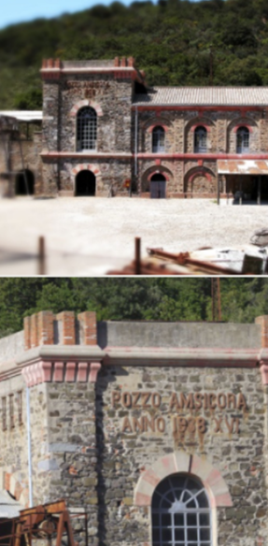
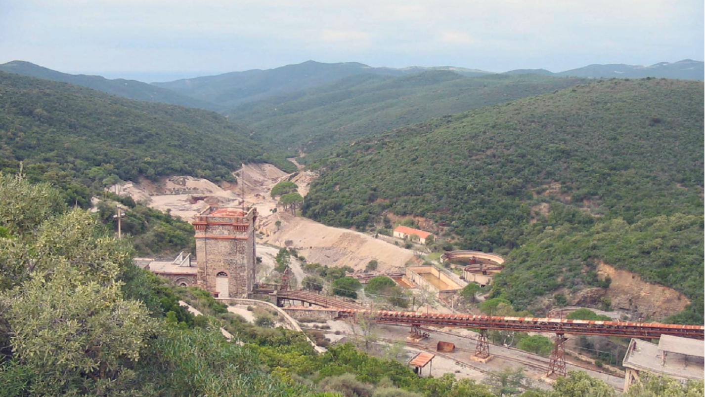
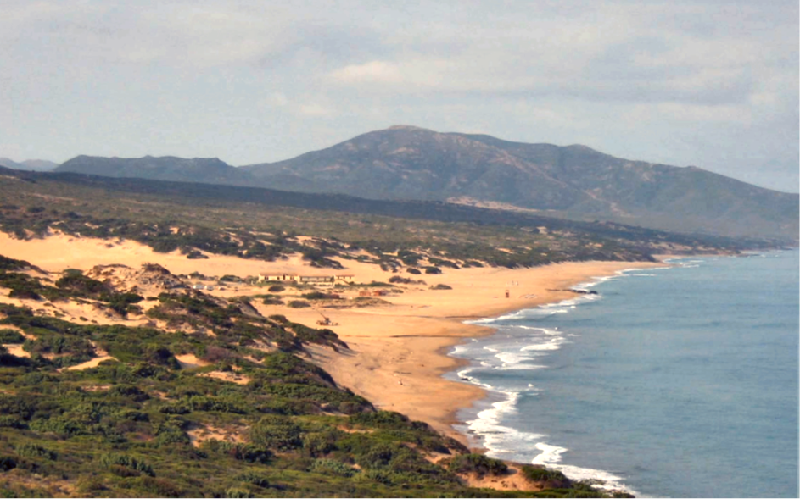
The redevelopment of the mining area
In the Montevecchio site there are several areas suitable for touristic re-development through:
the recovery of historical mine industrial buildings
the restoration of historical mine accommodations
the setting of naturalistic trail itineraries
Local communities have already identified and partially restored some of these areas
Management of HM soil contamination and risk assessment should account for the public health needs related to the future redevelopment

Slide 4



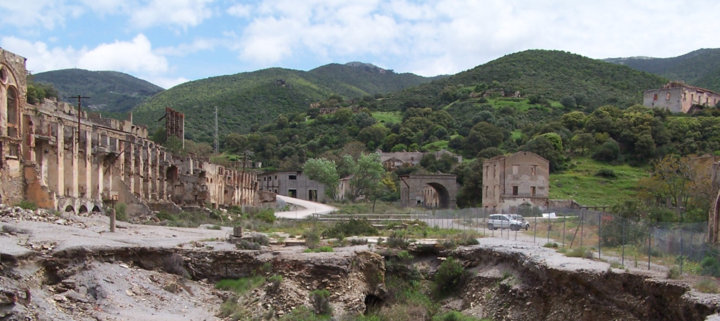


Contamination management needs
First thing to do:
best environmental results in a sustainable way but…
Is the process actually reversible?
Context: natural beauty of the landscapes, environmental constraints, mountainous areas
Soil & Mining Waste Dumping in
Main Disposal Sites (MDS)?
Where?
Not enough space
Data: 55 km² wide area,144 mining dumps, total source extent 600.000 m²
RISK ASSESSMENT
based on the real fruition of the areas
and on future redevelopment
Ranking of pollution sources
and definition of appropriate
remediation/management solutions
Identification of sub-areas suitable for potential redevelopment (APV)

Slide 5
Considerations on the exposure to Heavy Metals in soil in a big mining area
Local vs diffuse soil pollution
Pb
The assessment of a wide former mining area is border line between the evalutaion of «local» and «diffuse» pollution
The contribution of multiple sources has been assessed trough an «exposure based» approach
Natural backgound
Local soil contamina-tion
Food
(not coming from cont. soil)
Other sources
Diffuse pollution
Pb Exposure
Local contamination
Diffuse contamination
Source Identification
Preliminary investigation/ Main site investigation
Risk assessment
Establishes if risks (both HH and environmental) associated to soil/GW sources are unacceptable/ significant
Action
Interventions are focused on the source removal (remediation) or on reduction/mitigation of the migration pathways (risk reduction)
Identification of contaminant sources in soil and/ or groundwater
Affected areas are generally not wide
No Source Identification
Source is not known, or it is «diffused»
Exposure assessment
Evaluation of HH exposure to chemical levels in different media/routes (including soil and GW)
Action
Action on sources (when known) is the prevention of soil/GW contamination
No acceptable risk level can be pre-defined
Management/reduction of high exposure levels (e.g. use limitations)
Potentially affected areas are generally wide

Slide 6
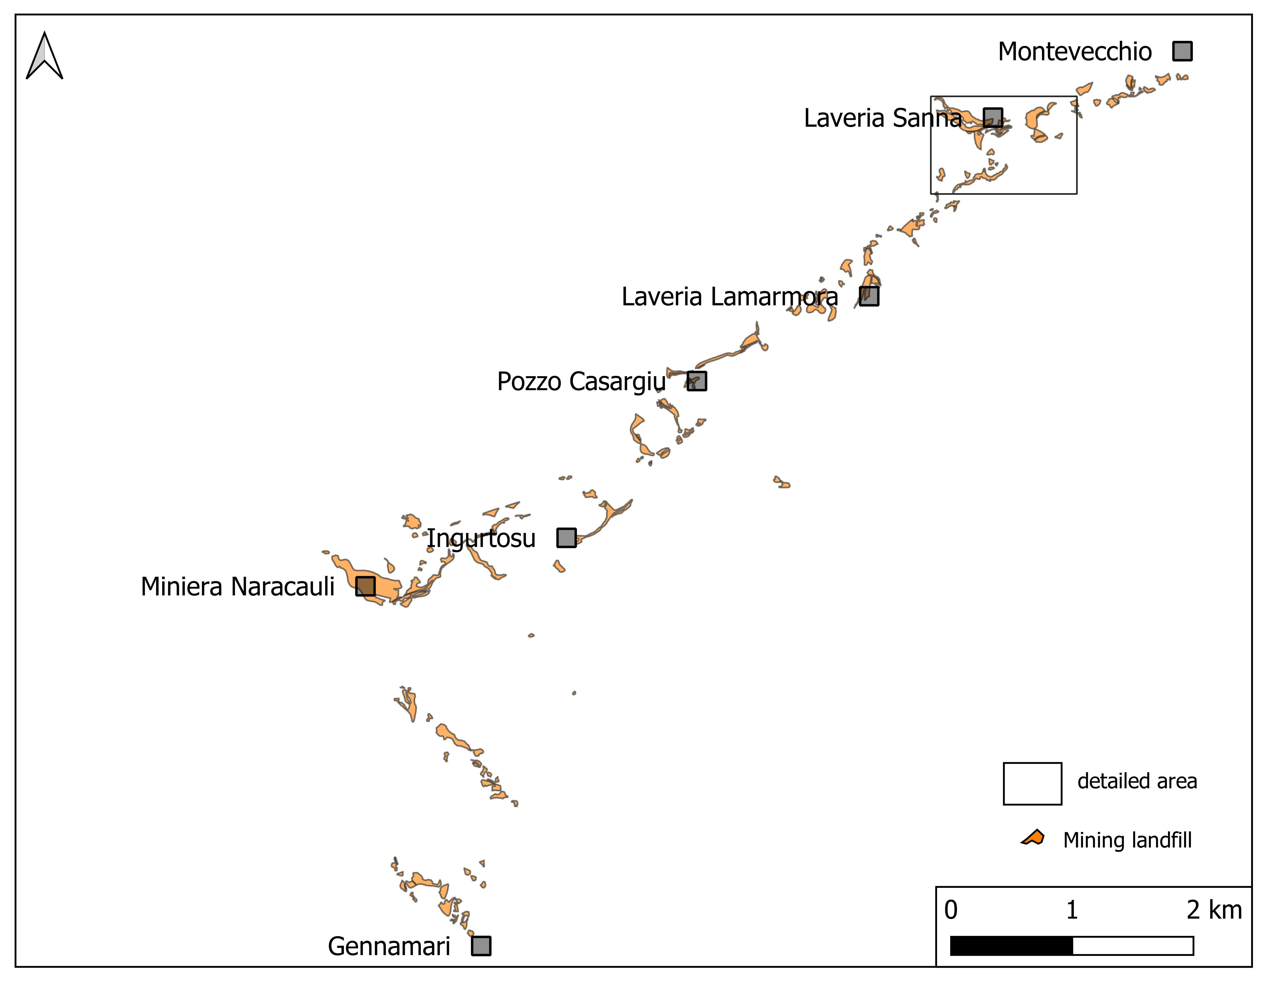
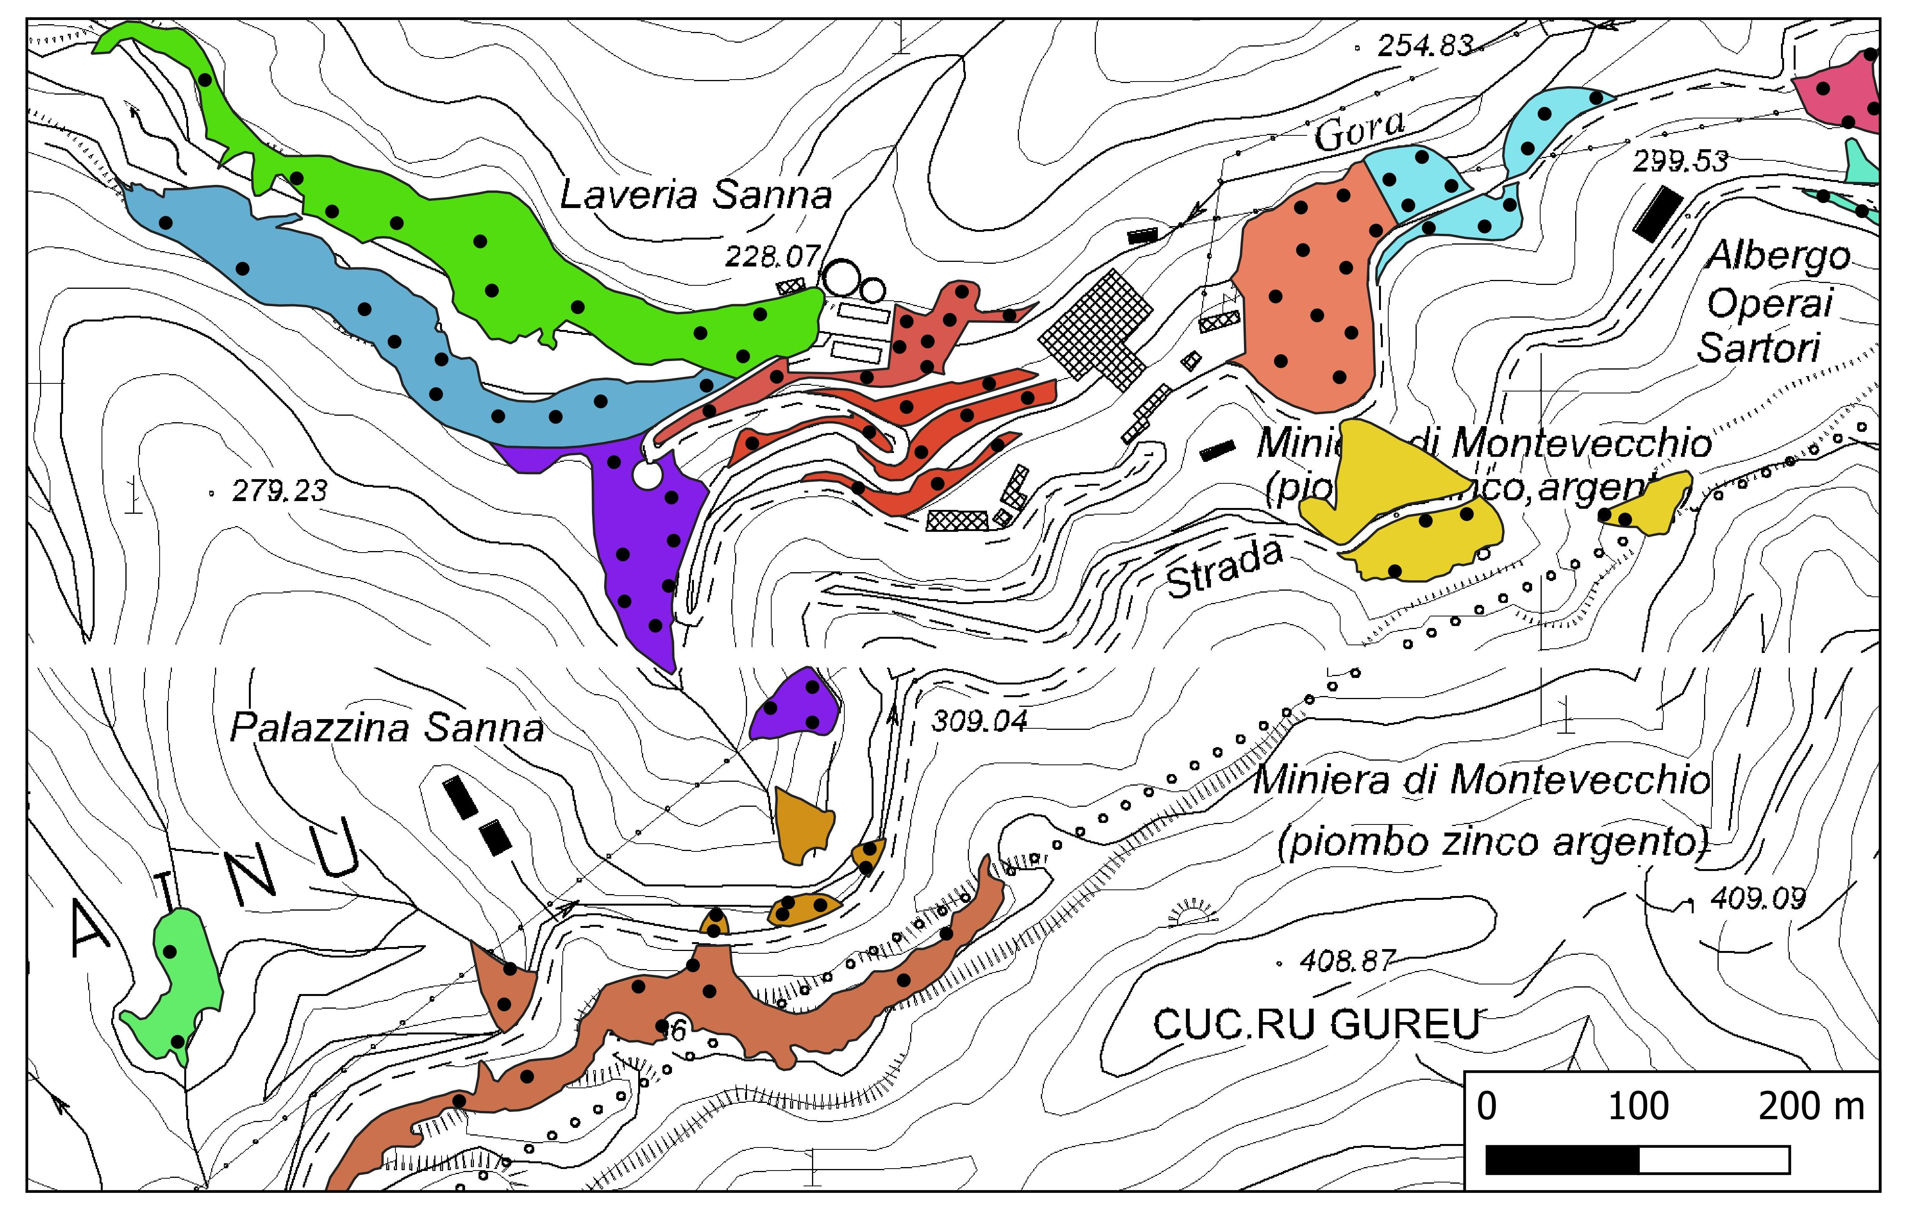
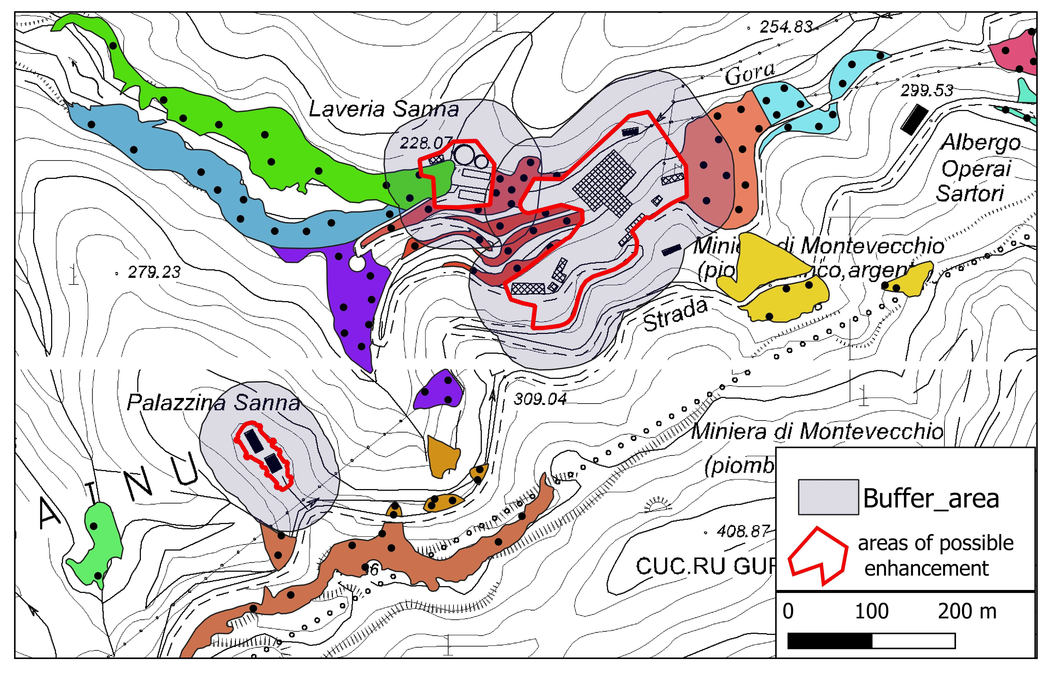
Risk-based main site investigation
Identification of 7 homogeneous areas interested by waste deposits
In 81 composite soil samples representative of 810 sampling points:
  Total content of As, Cd, Co, Cu, Hg, Pb, Sb e Zn in fractions less than 2mm and less than 0,63 μm (representative for dust emissions)
  Bioaccessible fraction of all HM (Glicine extraction Method EPA 9200.2-86, 2012)
  Tessier sequential extraction for all HM
  Granulometric classification
On 50% of soil samples determination of HM in EDTA (bioaccessibility for plant uptake)
Identification of areas suitable for redevelopment
Extension of the relevant exposure assessment to a 50 m buffer outside the areas of possible enhancement

Slide 7



Conceptual Site Model for Human Health Risk Assessment
Exposure scenarios
Recreational “hiker/tourist”: occasional exposure for 15 days/year concerning children, adolescents, adults and elderly
Recreational “standard”: continuous exposure for 350 days/year concerning children, adolescents, adults and elderly
Commercial: permanent workers (e.g. managers of tourist and excursion activities)
Evaluation of Residential scenario in case of redevelopment for stable residential use
Exposure routes
Soil ingestion + Dermal Contact (on-site)
Dust ingestion (on-site and off-site)
Dust inhalation (on-site and off-site)
Vapour Inhalation (on-site and off-site) for Hg
For Scenario I (tourist) exposure has been always considered on-site (i.e. on-source). For other scenarios exposure has been considered on-site (i.e. on-source) only for sources “touching” the 50m buffer around the areas of potential redevelopment

Slide 8
Exposure Parameters
Exposure parameters revision as follows:
  detailed age classes;
  daily frequency indoor and outdoor based on national data;
  soil and dust ingestion rates differentiated;
  soil and dust ingestion rate revised according to time spent in indoor and/or outdoor environments
 | Unit | Residential |  |  |  | Recreational (standard) |  |  |  | Industrial/Commercial
 |  | Child | Adolescent | Adult | Senior | Child | Adolescent | Adult | Senior | Indoor/ outdoor activity | Mainly outdoor activity | Mainly indoor activity
 |  | 0-6 yr | 7-16 yr | 17-65 yr | over 65 yr | 0-6 yr | 7-16 yr | 17-65 yr | over 65 yr
General Parameters
Exposure frequency | d/yr | 350 | 350 | 350 | 350 | 350 | 350 | 350 | 350 | 250 | 250 | 250
Exposure Duration | years | 6 | 10 | 14 | 5 | 6 | 10 | 14 | 5 | 25 | 25 | 25
Body weight | Kg | 15 | 44 | 70 | 70 | 15 | 44 | 70 | 70 | 70 | 70 | 70
Averaging time non cancinogens | years | 6 | 10 | 14 | 5 | 6 | 10 | 14 | 5 | 25 | 25 | 25
Averaging time cancinogens | years | 70 |  |  |  | 70 |  |  |  | 70 | 70 | 70
Dust and vapour Inhalation
Daily frequency indoor | hr/d | 19,8 | 19,6 | 18 | 22,4 | 0,4 | 0,6 | 1,4 | 1,4 | 8 | 1,5 | 8
Daily frequency outdoor | hr/d | 0,7 | 0,5 | 0,9 | 1,9 | 0,6 | 0,9 | 0,8 | 0,6 | 8 | 8 | 1,5
Soil and Dust Ingestion
Soil+Dust ingestion rate | mg/d | 23 | 7 | 6 | 14 | 20 | 12 | 6 | 4 | 5 | 5 | 5
Dust ingestion rate | mg/d | 12 | 3 | 3 | 7 | 10 | 6 | 3 | 2 | 3 | 3 | 3
Dermal Contact
Total skin area | cm² | 7600 | 15900 | 21500 | 20800 | 7600 | 15900 | 21500 | 20800 | 21500 | 21500 | 21500
Dermal adherence factor | mg/cm²-d | 0,128 | 0,128 | 0,116 | 0,116 | 0,164 | 0,164 | 0,375 | 0,116 | 0,236 | 0,236 | 0,236

Slide 9
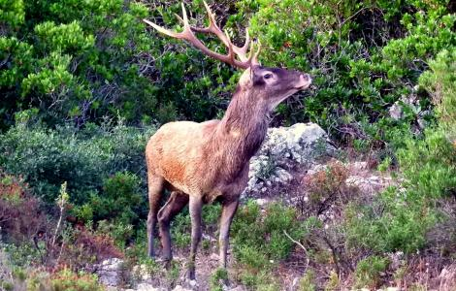
Conceptual Site Model for Environmental Risk Assessment
Evaluation of soil contamination transfer through food chain
Soil to plant uptake
Consumption of vegetable species (grass) grown on potentially contaminated soil by relevant environmental receptors (herbivores)
Potential use of vegetable species (grass) grown on potentially contaminated soil grass for forage production (compliance with EU thresholds for food intended for animals - Directive 2002/32/EC)
Evaluation transport/attenuation of contamination trough surface water and sediments
Hydrological tracer techniques were applied to assess the HM loads from mining sources
An evaluation of attenuation processes due to hydrological and biogeochemical conditions has been made too

Slide 10
Pb bioaccessibility for soil ingestion
High variability of bioaccessible content of Lead has been found in natural deposits and it is almost correlated to total content
Bioaccessibility seems also to be not strictly influenced by the abundance of fine (< 0,63 mm) or coarse fractions (between 2mm and 2cm) but high bioaccessibility values are generally associated to high abundance of fine fractions

Slide 11
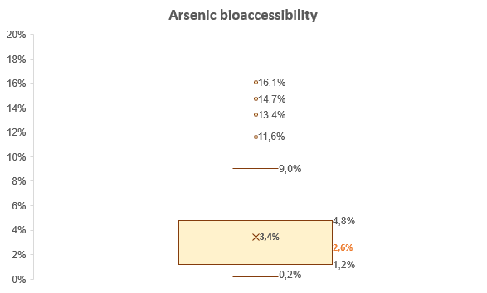
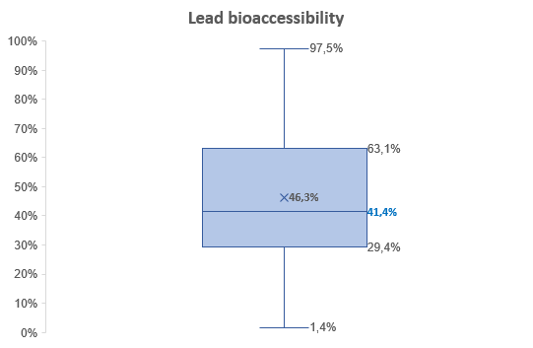
As vs Pb bioaccessibility for soil ingestion
Arsenic is another contaminant found at high concentration in mineral and natural deposits
But Lead showed a highest bioaccessbility for soil ingestion pathway with respect to Arsenic
Bioaccessible content has been used as input concentration for soil and dust ingestion pathways but not for dermal contact
However dermal contact has been considered as a critical pathway only if combined with soil ingestion

Slide 12
Pb bioavailability for plants
High variability has been registered also for available Lead. Higher correlation with total content is reported with respect to bioaccessibility for soil ingestion.

Slide 13
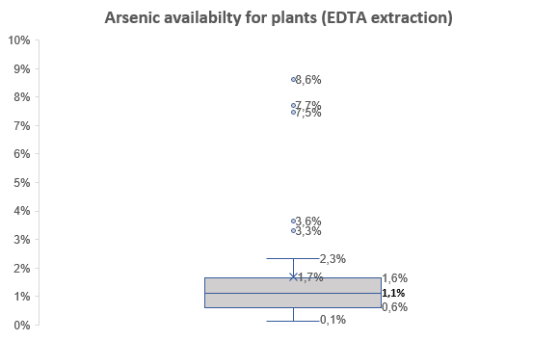
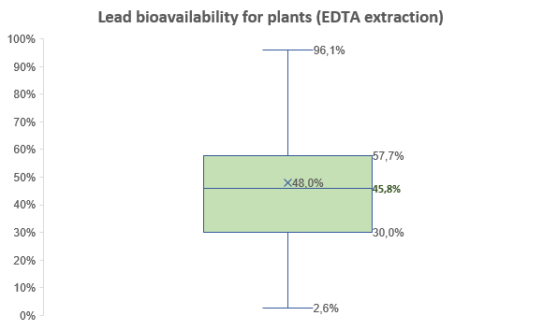
As vs Pb availability for plant uptake
A comparison between Lead and Arsenic has been made also for plant availability. Again, Lead showed a highest values of bioavailable concentrations with respect to Arsenic.

Slide 14
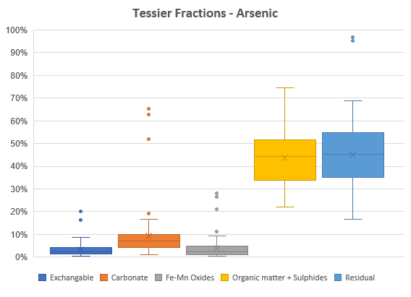
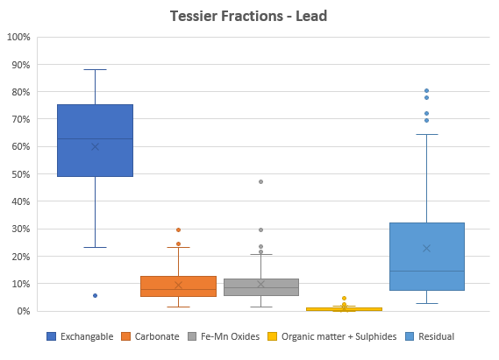
Tessier fractions
The distribution of Tessier fractions shows again the different general behaviour of As and Pb
As is mainly distributed in less mobile fractions (i.e. slowly mobilizable forms related to organic matter and sulphides and immobile forms)
Pb is mainly distributed in more soluble forms (exchangeable forms weakly adsorbed), but a relevant part presents also a low mobility

Slide 15
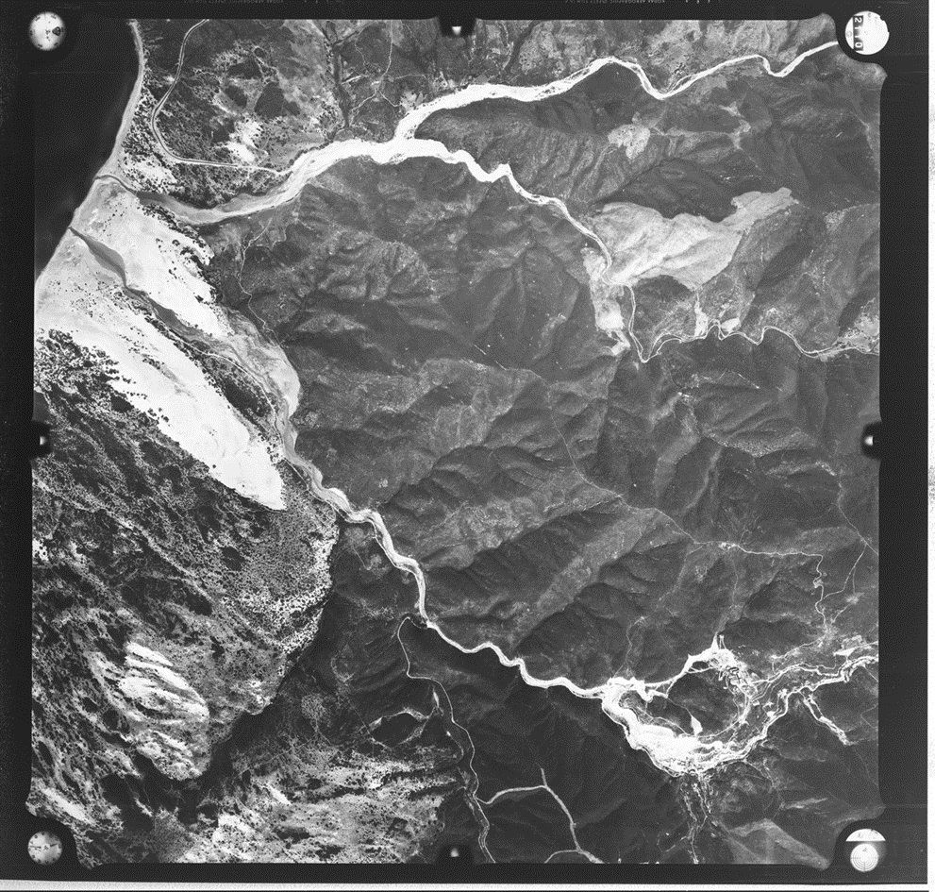
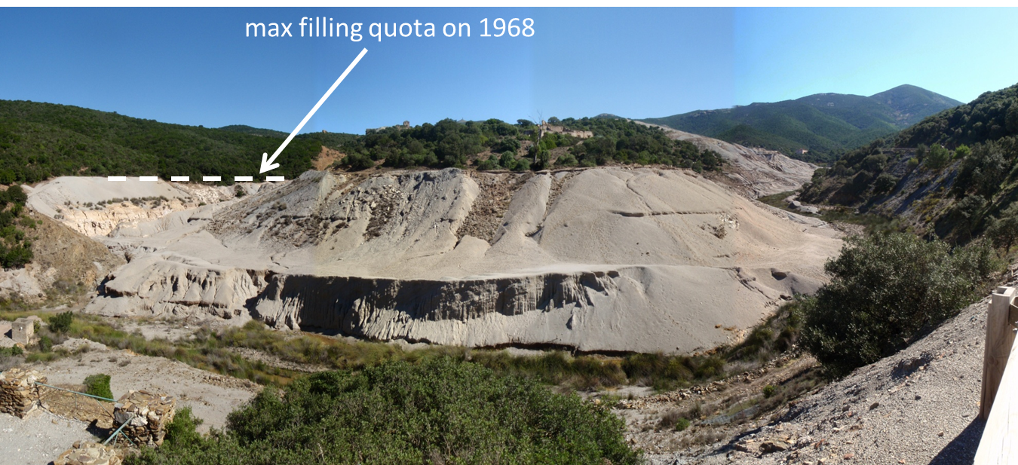
River water and riverbed: Rio Naracauli

Slide 16
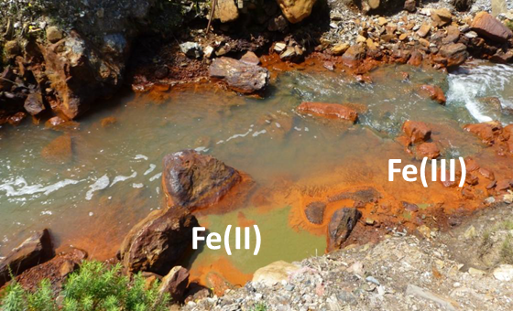
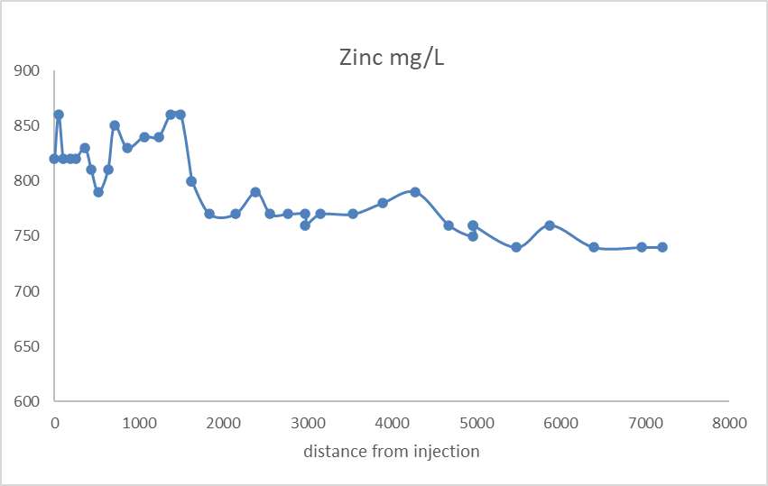
River water and riverbed: Rio Irvi
C

Slide 17
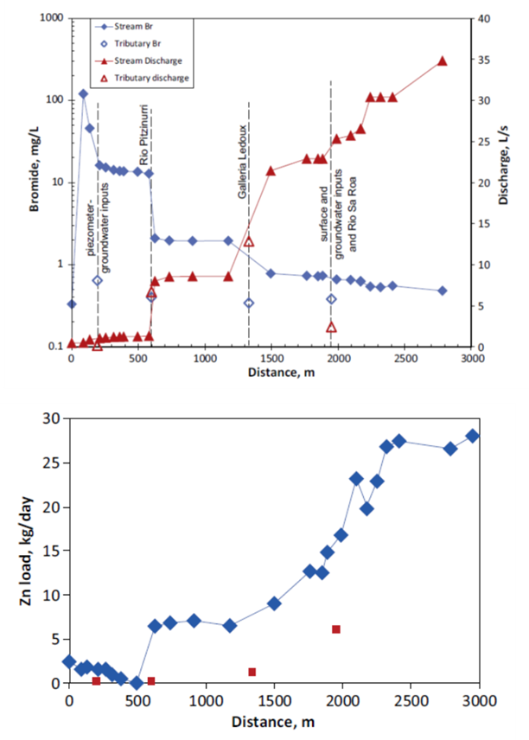
Heavy Metals loads in rivers
Zinc load due to interaction between water and mine-waste

Slide 18
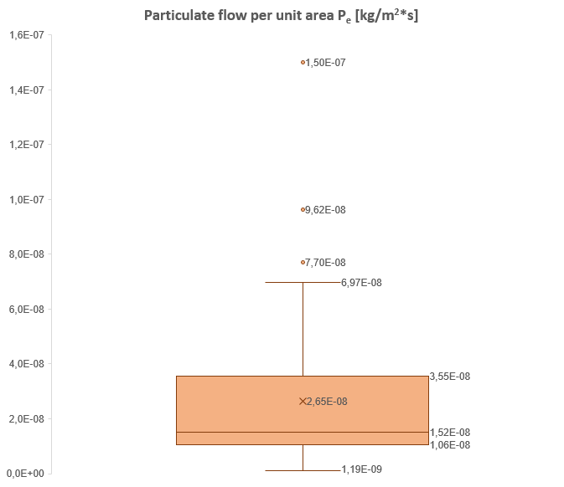
Validation of a new particulate emission model
The dust inhalation pathway is unlikely to be critical, even in the presence of very high contaminant concentrations in soil (orders of magnitude higher than the CSC) and high erosion potential. This is probably caused by an underestimation of the emission of particulates from soil.
New particulate emission model have been tested in the Montevecchio Ponente wide area. In particular, the parameter “Particulate flow per unit area – Pe” has been estimated from the measured erosion potential of the surface soil layer finest fraction (< 0.063 µm) in all the relevant sites.
Results show a substantial agreement of Pe estimated from new model and the central tendency of the experimental data.
Pe default value of 6,9 E-13 [kg/m²*s] is currently used
P_{e} (new model)
1,62 E-08

Slide 19
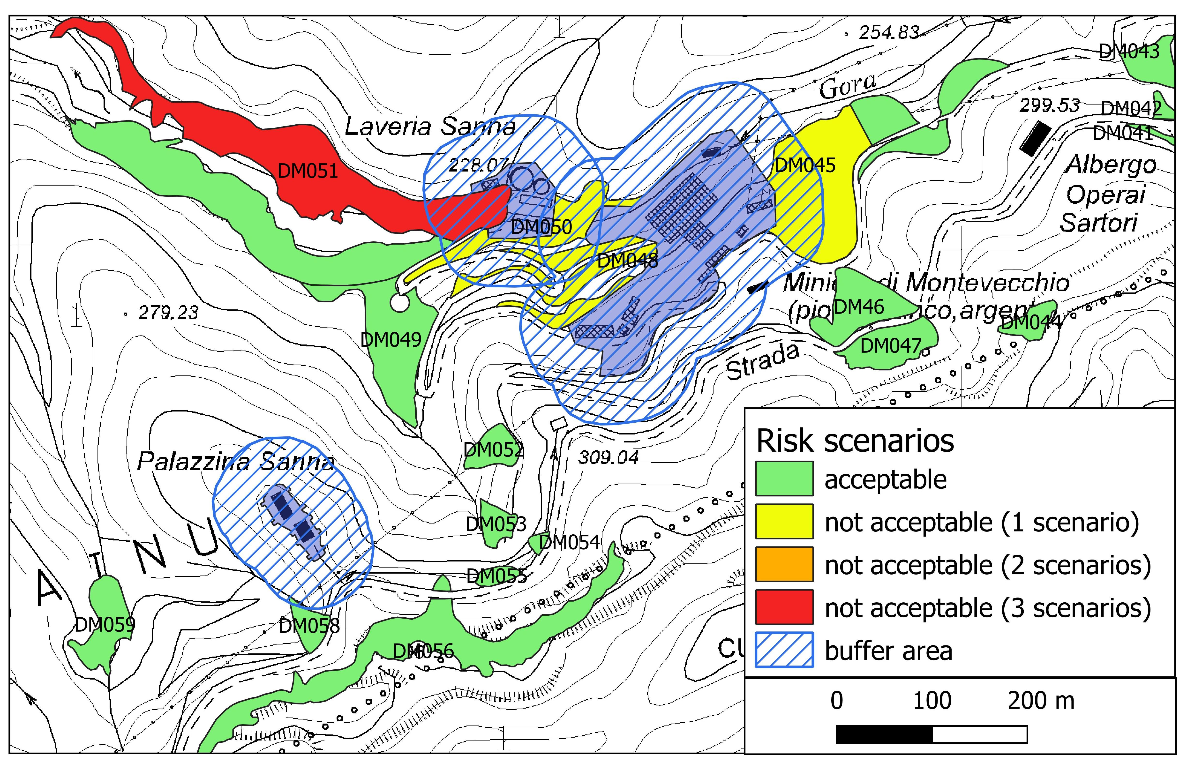
Results of Human Health Risk Assessment
Prioritization of interventions on sources
According to the main 3 scenarios (Recreational “hiker/tourist”; Recreational “standard” and Commercial), the following classification of sources have been obtained:
sources with unacceptable risks for all the exposure scenarios assessed (red)
sources with unacceptable risks for two of the three exposure scenarios assessed (orange)
sources with unacceptable risk values for a single exposure scenario assessed (yellow)
sources for which there are no significant risks for all the evaluated scenarios (green)
Priority of interventions on red sources with source removal or isolation
For less priority sources a limitation of exposure routes (e.g. naturalistic engineering/vegetable cover) is envisaged

Slide 20
Results of Human Health Risk Assessment
Real remediation/management needs
More than 50% of source areas do not need any action and are ready for redevelopment (green)
To more than 30% of source areas “soft” risk management solutions compatible with touristic redevelopment may be applied (yellow)
Arsenic and Lead soil contamination is the main human health “risk” driver
Redevelopment to residential use
The possibility of a complete residential redevelopment has been assessed
Sources with unacceptable risks for residential scenario are evidenced in purple

Slide 21
Results of Environmental Risk Assessment
The environmental assessment related to contamination transfer in the food chain highlighted a low environmental quality of the matrices due to the significant assimilable levels (EDTA values) of Lead and Cadmium
However, the comparison with the thresholds above which negative effects occur, also considering the numerous precautionary hypotheses adopted, excluded potential significant risks for the environmental endpoints (herbivores) representative of the fauna present in the areas covered by this study
The plant species present on sources are not suitable for the forage production as they have potential levels of Lead and Cadmium higher than the reference values provided for by the EU Directive on feed for animal nutrition
The presence of dense vegetation in the riverbed favor natural attenuation of metals in river water.
The biogeochemical processes can lower metal loads in river water by orders of magnitude

Slide 22
Conclusions
The initial phase of comparison of total and/or bioaccessible content of HM in soil with “screening values” (for Pb are 100 mg/Kg for residential/green/agricultural use and 1000 for industrial/commercial use) was not effective in identifying effective management solutions with the consequent barrier to the redevelopment
The detailed investigation and the Human Health Risk Assessment according to the re-use of the areas was effective in identifying real management needs particularly for As and Pb contamination and oriented the solutions in a more sustainable way, avoiding “dig and dump” or containment of million of m³ of contaminated materials
The Environmental Risk Assessment has excluded potential significant risks for the environmental endpoints (herbivores) related to soil contamination but on the other side highlighted a low quality of the environmental matrices due the significant assimilable levels of Pb and Cd
The evaluation transport/attenuation of contamination trough surface water and sediments suggested to move to natural solutions: building small dams along the riverbeds of Irvi and Naracauli to create wetland-like areas and renaturalizing these with Phragmites australis (already present in the area)
This system will favor sedimentation regime and, thus, effective and low-cost natural abatement of metal and sulphur loads
Remediation projects on “priority” sources are being planned and public funds are available for reclamation/redevelopment

Slide 23

THANK YOU FOR YOUR ATTENTION! antonella.vecchio@isprambiente.it
People are very open-minded about new things as long as they're exactly like the old ones
(Charles F. Kettering)

