Slide 1
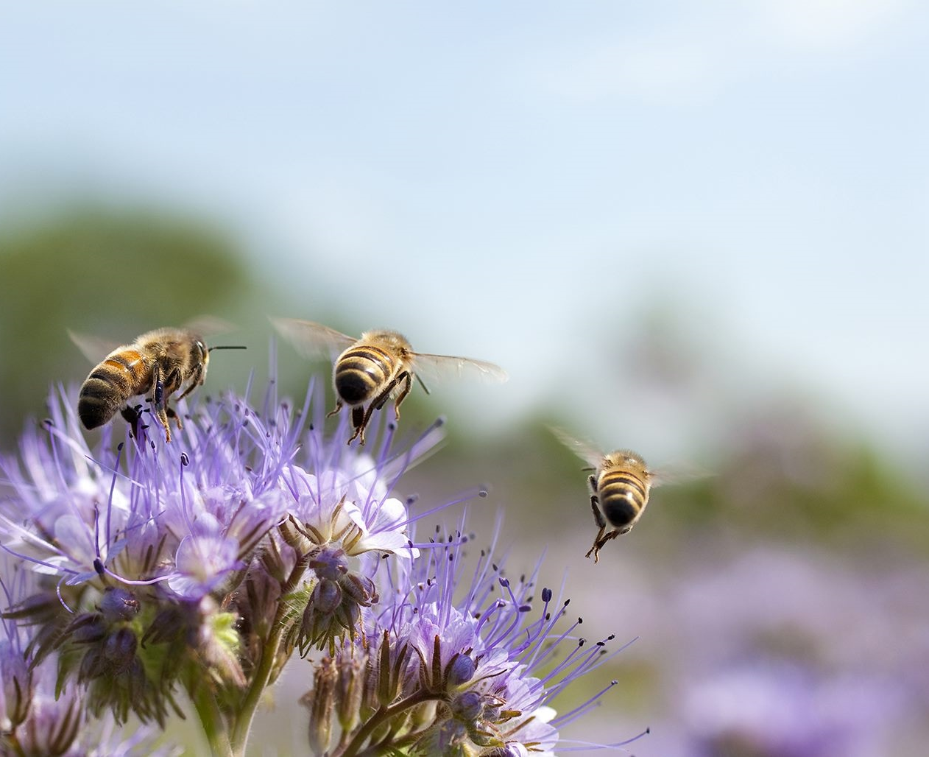
Phytoremediation as a way of improving underground and above ground biodiversity
NICOLE spring workshop
4th & 5th may 2022

Slide 2
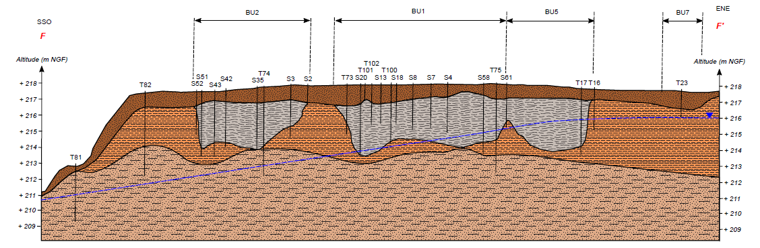
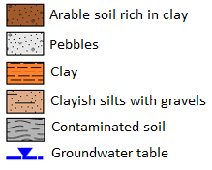
Presentation of the site and issues faced
A storage facility for soil contaminated with oil drilling mud
Average TPH content = 30 000 mg/kg, volume = 16 000 m³
Rural area, remote location, no water or electricity
No time constraint – future use : agriculture
“Soft” remediation technics :
bio and phytoremediation
Goals for the remediation :
achieve pollution abatement,
limit installation and operating costs
regenerate soil of good agronomic quality, suitable for cultivation

Slide 3
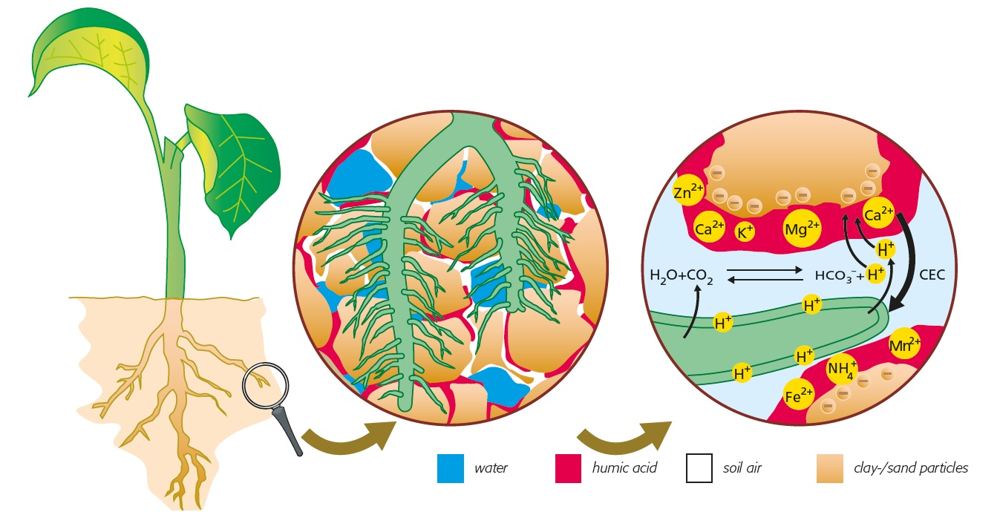
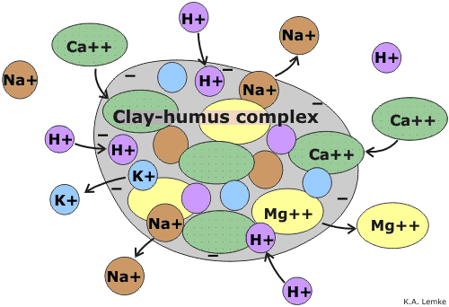
Focus on the soil as a living ecosystem
pH
Nutrients content
Organic matter
Hydrocarbon content
NPK
CEC & base saturation
Chemistry
Biology
Physical
Humintech GmbH
Water holding capacity
CEC
Nutrients cycling
Micro organisms abundance and diversity
Meso-macro fauna
Plants & rhizosphere
Texture
Porosity
Compaction
Structure
Surface sealing
Aerial part : plants counting, vegetation cover and height, growth stage, mass, hydrocarbon content
Underground part : roots counting
Overall : omega 3
K.A. Lemke

Slide 4
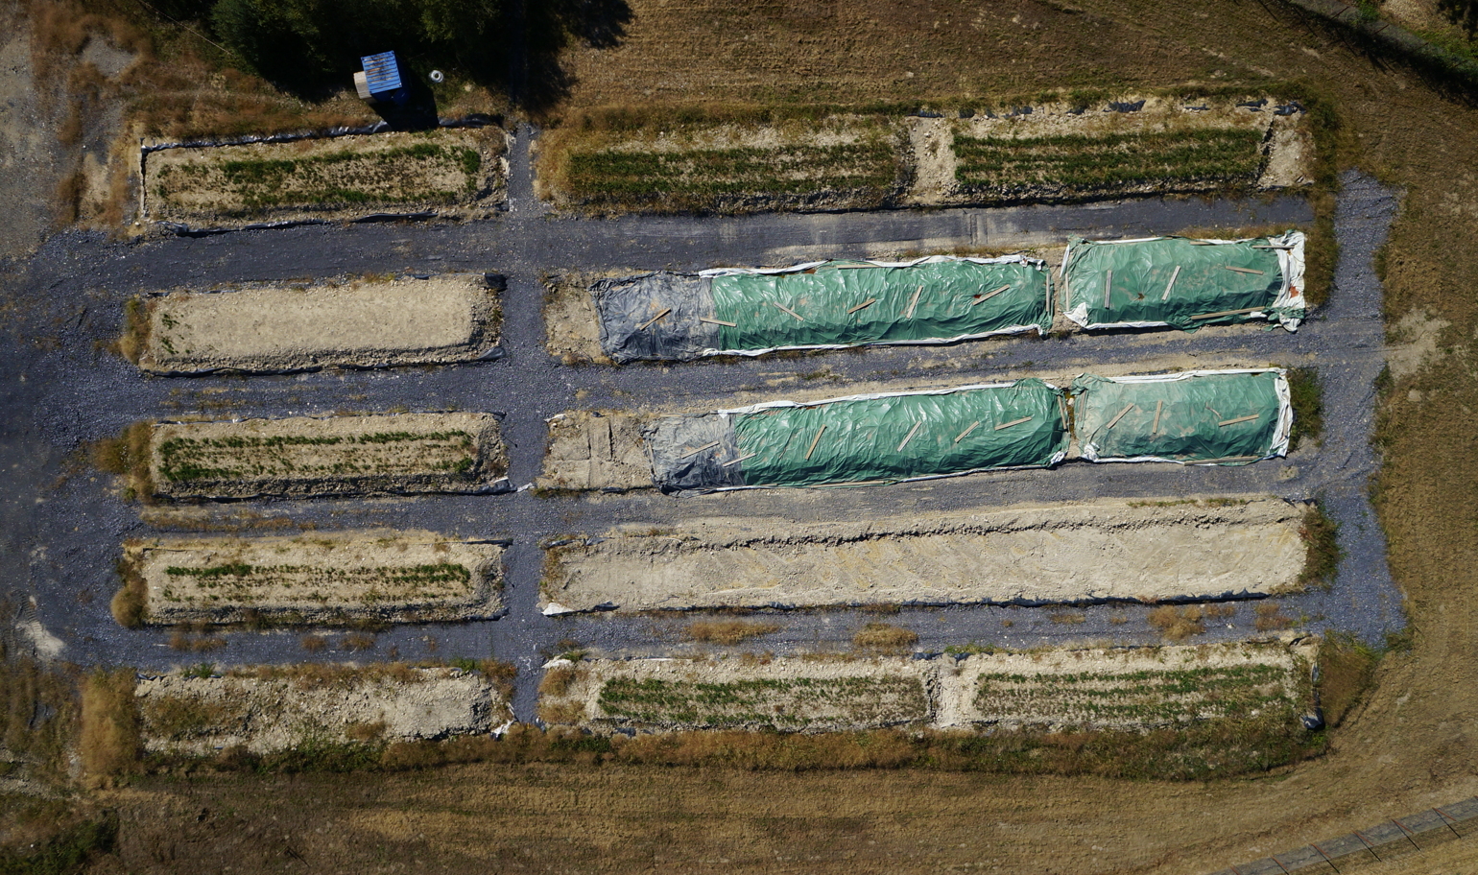
Experimental protocol
Goals for the pilot test :
Assess the benefits of phytoremediation vs bioremediation
Determine best conditions for the treatment
Scale up the treatment : residual pollution, length, costs, organisation, etc.
Control plots : arable soil planted with same species + pile of contaminated soil
A
bioremediation
B
bioremediation + phyto remediation at T+2M
B4/6a
C2/8
C4/6
C
bioremediation + phyto remediation at T+4M
A2/8
A4/6
B2/8a
A 4/6 a
A4/6a
B4/6
A2/8a
B2/8
mixing platform
bio / phyto remediation
Composition polluted soil / arable soil + compost
amending (lime)
mixing platform
C2/8a
C4/6a

Slide 5

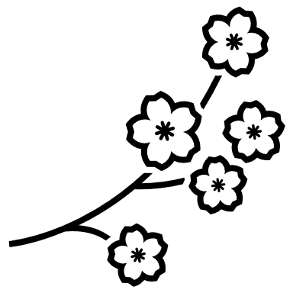







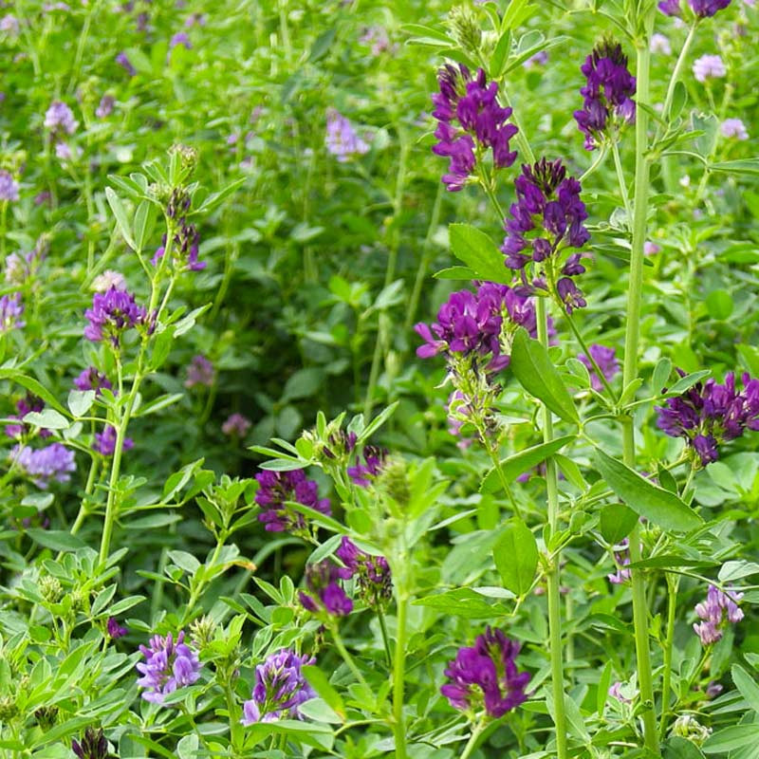
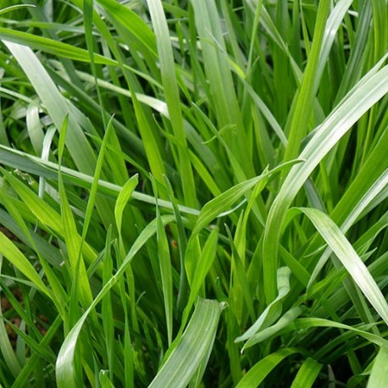
Selection of the plants
A multi parameters choice :
Schedule and organization of the pilot test (perennial plant, not a tree)
Adaptation to pedo climatic conditions
Complementarity of roots system
(tapping roots + fasciculate roots)
Cultivated species
(seed availability, references)
Agronomic qualities
(atmospheric nitrogen fixation, soil cover)
Potential for hydrocarbons remediation (bibliography)
Alfafa + English ray grass (local varieties)
Biodiversity ? 2 introduced species
Meant to enhance underground biodiversity (rhizobium leguminorasum)

Slide 6


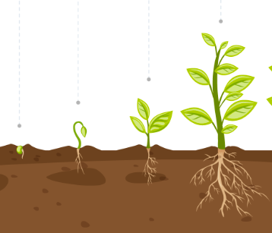


Cultural operations
Heavy rains
Drought
Agronomic approach and tools – Old farmer’s wisdom !
Prepare
Plant
Maintain
Protect
Harvest
Control purpose only
No yield objective
> Mowing and weighing aerial biomass
Piles
Soil surface
> Farm tool : harrow
Inoculation
Seeding density
NPK fertilizer = starter
> Agricultural references : technical institutes, producer union, etc.
No fertilization, no pesticide
Irrigation
> Calculation tools for water holding capacity, irrigation quantity
Overseeding

Slide 7
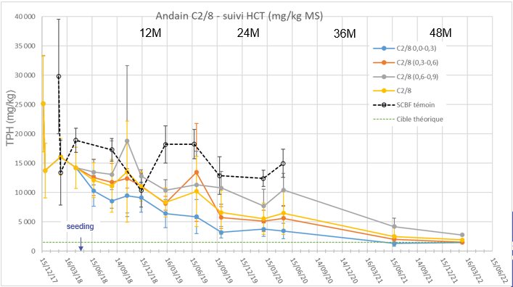
Results : pollution / microbial diversity
Similar evolutions
Reduction of pollution : similar concentration limit (~1900 mg/kg at 50M) and kinetics
Within rhizopiles, decrease in soil hydrocarbon content depends on roots progression through the pile → adjustment of the pile's height from 1m to 60 cm
Bacteria : increasing trend for activity (RNA/ DNA), with seasonal variations
Fongi : no significant evolution
Discussion : rhizosphere

Slide 8
Results : nematodes
A integrative bioindicator to assess the soil ecosystem health
Stable quantity, sensitivity to perturbations : 2 to 4 x more nematodes in rhizopiles
Nematods diversity, significative of a functional ecosystem : biopiles < rhizopiles < arable soil

Slide 9
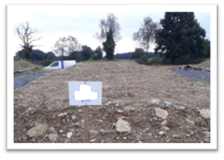
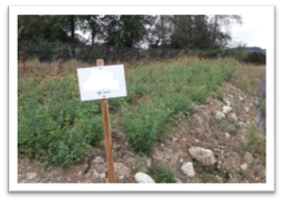
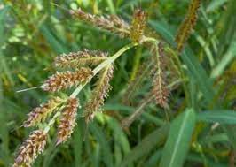
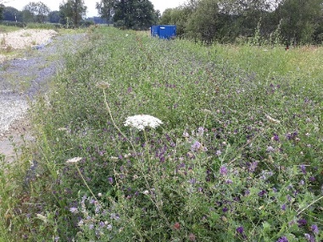
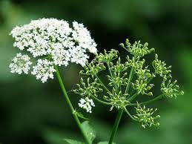
Results : plants growth and above ground biodiversity
BIOPILE
Coherent evolution for the various quantitative or qualitative indicators, indicators correlated with hydrocarbons & lime content () and season ()
Improvement over time (cf. omega 3 indicator) : plant adaptation (physiology), roots deepening, reduction of stress factors?
Evolution of the vegetation : species equilibrium vs “wild” species
“ Organic farming” : shelter for insects, small vertebrates…
(discussion : bioavailability according to type of pollutants)
Sept. 2018
RHIZOPILE
Sept. 2018
8M = 4 months after seeding
Echinochloa crus-galli
June 2019
OMEGA 3 - Luzerne
Apiaceae
18M = 14 months after seeding

Slide 10
Conclusion and future developments
Phytoremediation can be an effective remediation technic
It implies some constraints (time), the use of agronomic approaches and tools, and an ability to adapt to changing conditions to maintain the vegetation
Increase of biodiversity : rhizosphere ? for the microfauna and at the surface
Phytoremediation leaves a soil that has improved on the physical and biological part, as well as on the chemical aspect → a better balanced soil that has regained functions
Future trials : study of the rhizosphere, microbial diversity on the long run, inventory of the “wild” biodiversity (vegetation & fauna)
Design a more complex combination of plants to improve resilience to hazards and combine the advantages of various species
Ecosystem services / SDGs

Slide 11




Julie ESTIVAL – Sébastien KASKASSIAN – project team
+33 6 32 64 40 49
j.estival@tauw.com

