Slide 1
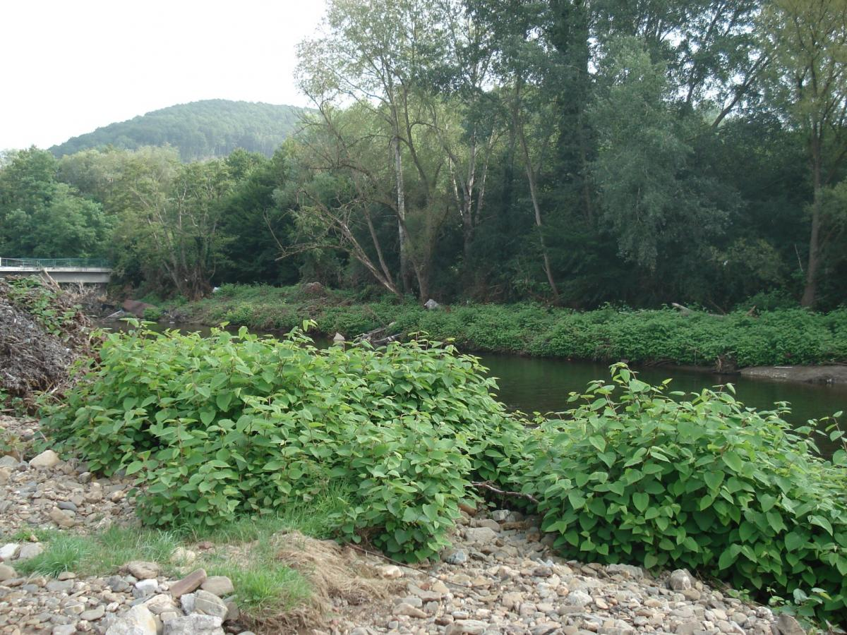
Reynoutria japonica in Wallonia
En : Japanese Knotweed
Fr : Renouée du Japon
June 10, 2022

Slide 2
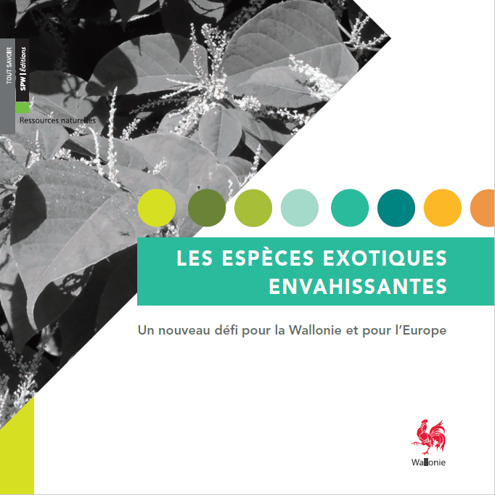
Japanese Knotweed in Wallonia
Invasive Alien Species managed by :
(interdepartmental cell on invasive species)
invasives@spw.wallonie.be

Slide 3
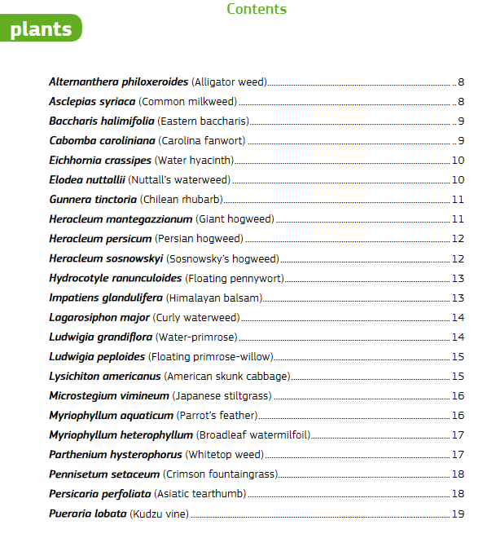
Japanese Knotweed in Wallonia
X

Slide 4
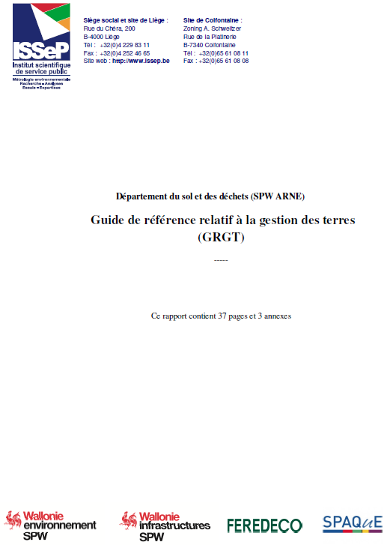
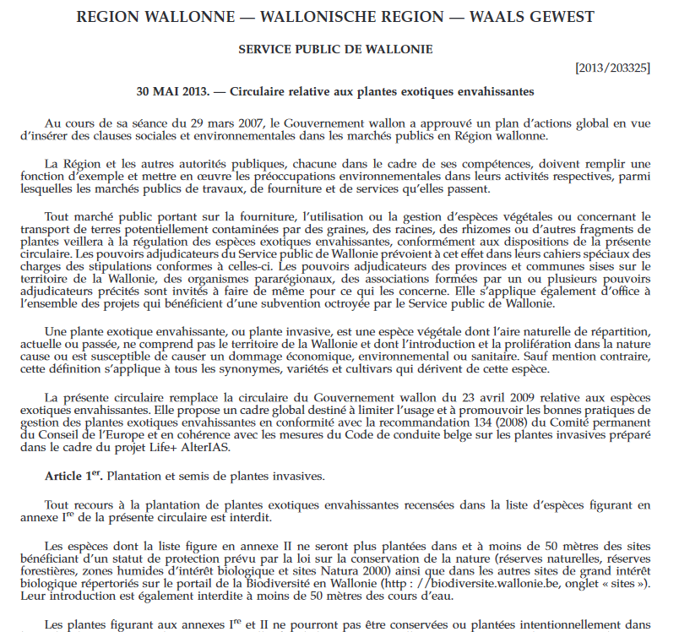
Japanese Knotweed in Wallonia
Types of measures

Slide 5
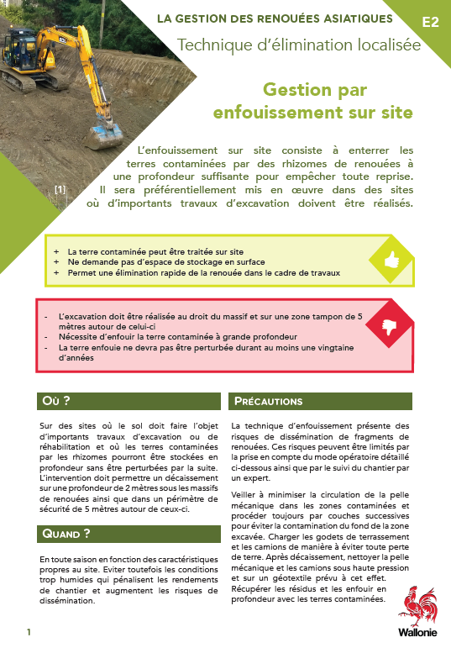
Japanese Knotweed in Wallonia
Fact sheets detailing 10 control techniques
Early eradication - Act as soon as knotweeds become established
management by manual uprooting
Localized elimination - Act on the roots
management by crushing and tarpaulin
management by on-site burial
management by earthwork and export
Attenuation_acting on the airborne organs
management by tarpaulin cover
management by repeated grubbing
management by systemic herbicide injection
management by grazing
management by repeated mowing

Slide 6
Japanese Knotweed in Wallonia
CELABOR
Research :
Resveratrol
ISSeP

