Slide 1

State of the art in UK
Richard Pormore
Joint Managing Director

Slide 2
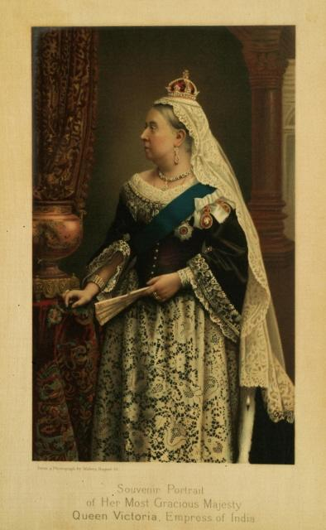

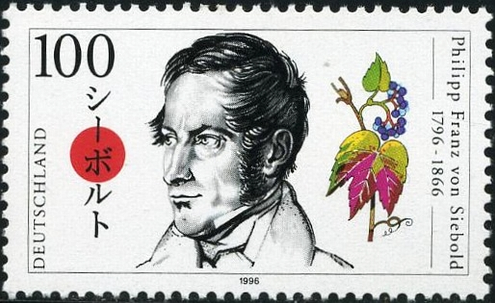
Originally bought over to the UK by the Victorians in the 1800’s
Notes:
Philipp Franz von Siebold Victorian Botanist. Victorians liked to brag/to show off
Popular on country estates providing ornamental value, as well as cover for game birds. The 20th century demise of many former country estates and the consequent lack of control has allowed invasive species to invade large areas of the British countryside. Von Siebold returned to Europe with over 12,000 foreign plant specimens and quickly established his Royal Society for Encouragement of Horticulture. In 1850 he sent a speculative batch of his plants to Kew Gardens in London. Unwittingly his industriousness sowed a pestilential mistake on the British Isles.
Neat handwriting in the Kew Inwards Book notes, somewhat sternly, that only six of von Siebold’s plants are thought to be new to the Gardens. One of these is Item 34: ‘Polygonum Sieboldii’, the single female plant that every present day Japanese knotweed plant in Britain is descended from.

Slide 3
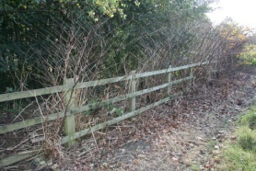
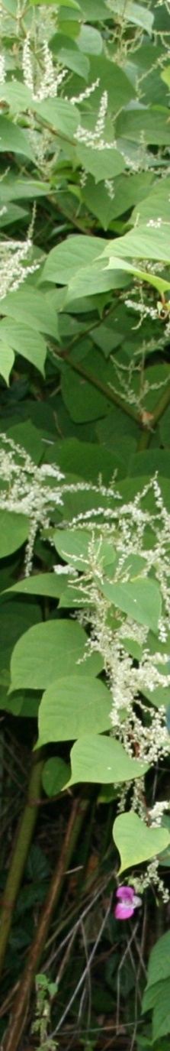
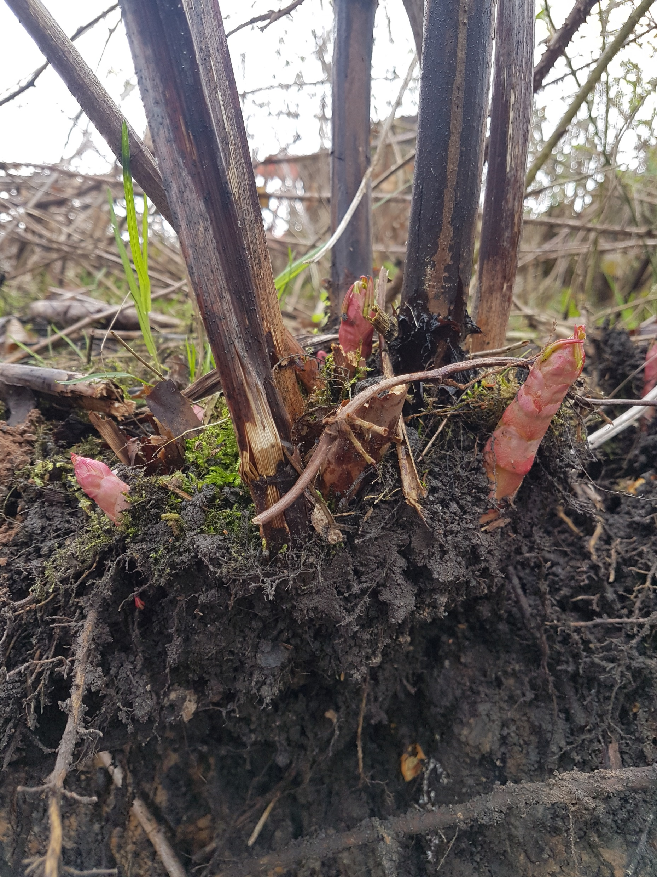
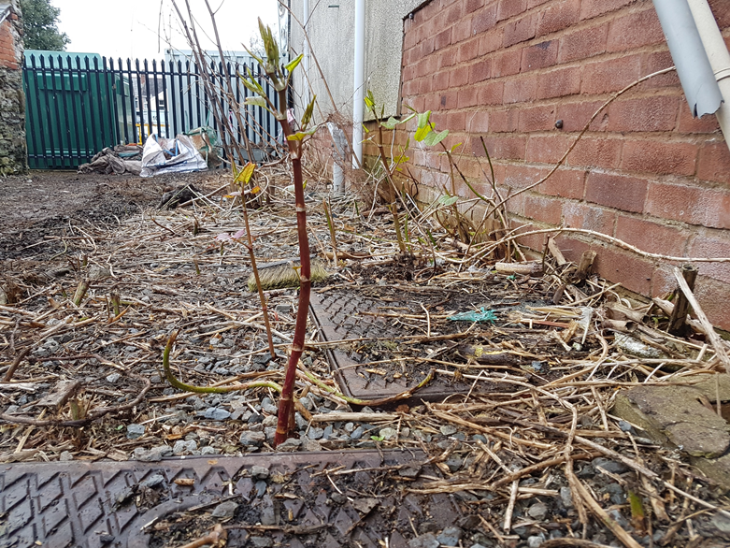
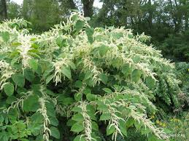
Japanese Knotweed
Notes:
First stages March to April– edible. May to July it starts to take on its distinctive appearance of bamboo like canes with bright shield/heart shaped leaves Starts Flowering around august – white flowers. November to February established strands of Knotweed die back and no leaves remain. Canes are woody and brittle. Hold up the cane – rhizome straight into ground
Japanese knotweed has hollow stems with distinct raised nodes that give it the appearance of bamboo, though it is not related. While stems may reach a maximum height of 3–4 m (9.8–13.1 ft) each growing season, it is typical to see much smaller plants in places where they sprout through cracks in the pavement or are repeatedly cut down.

Slide 4
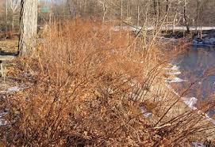
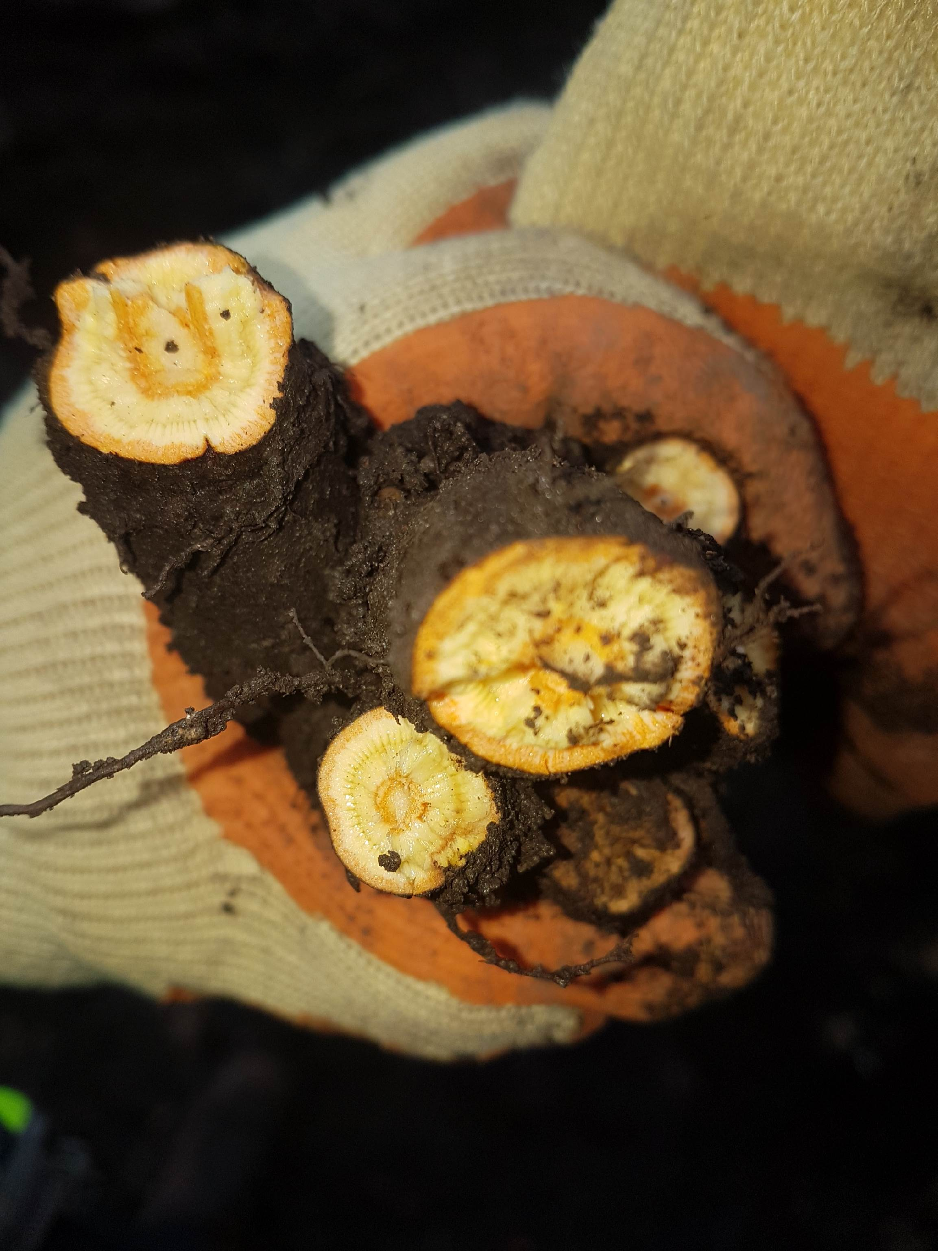
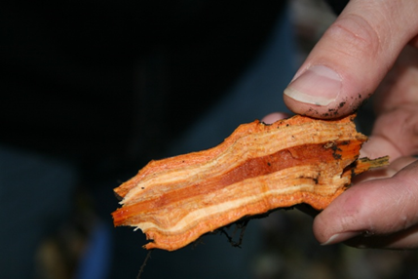

Slide 5
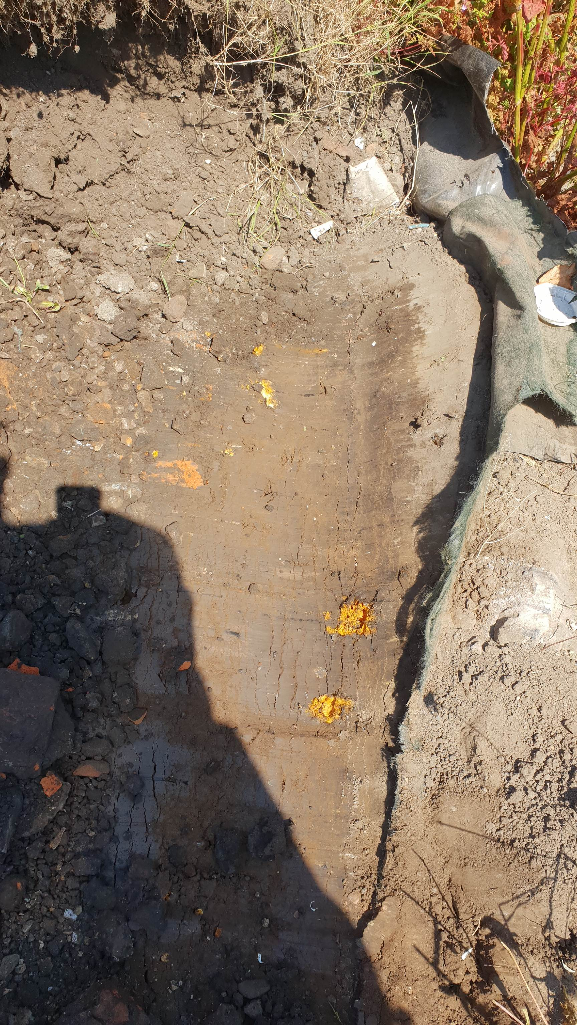
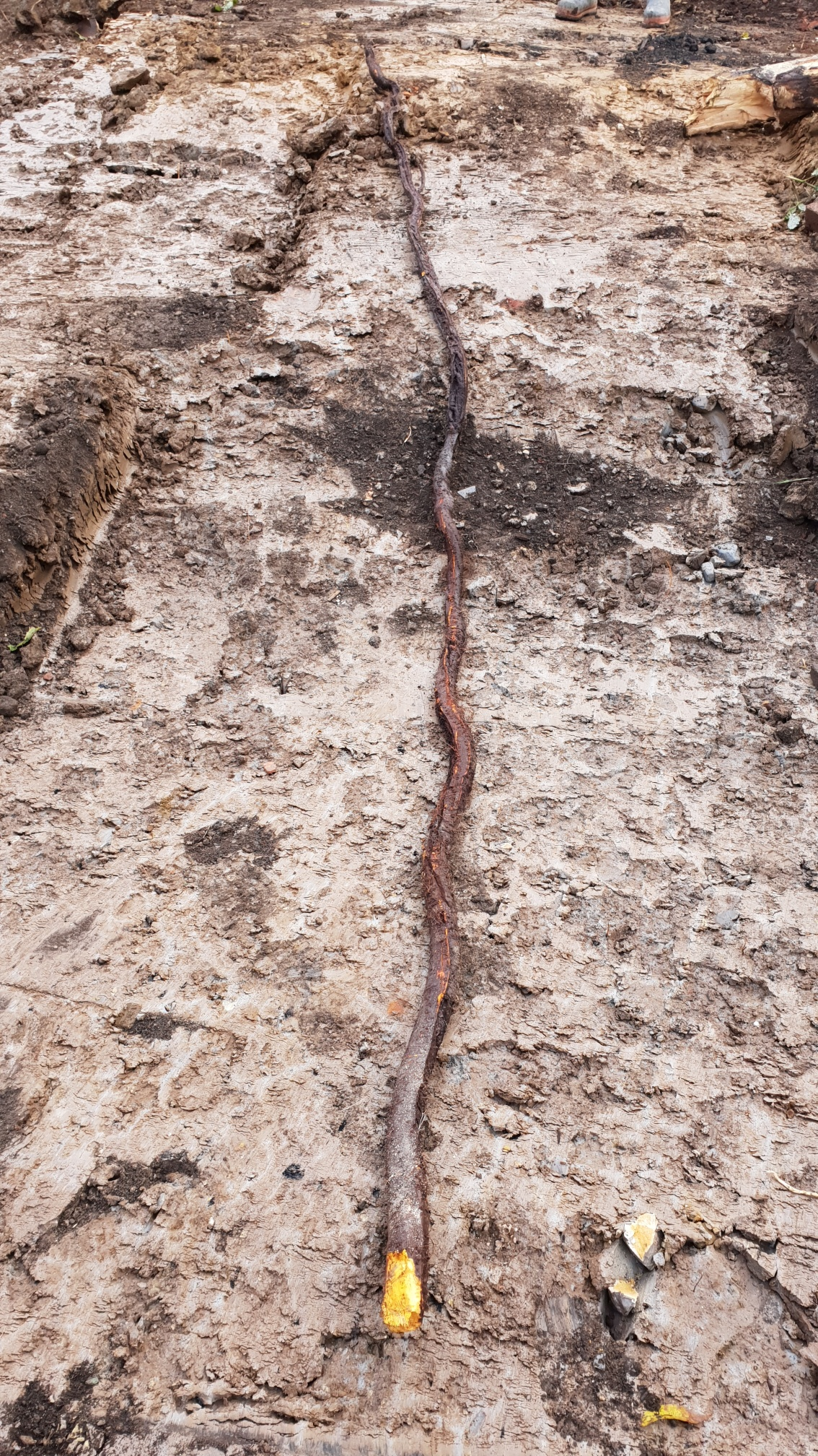
Notes:
3 m long 3 inch thick tapering to one inch, it was pulled out of a drain

Slide 6
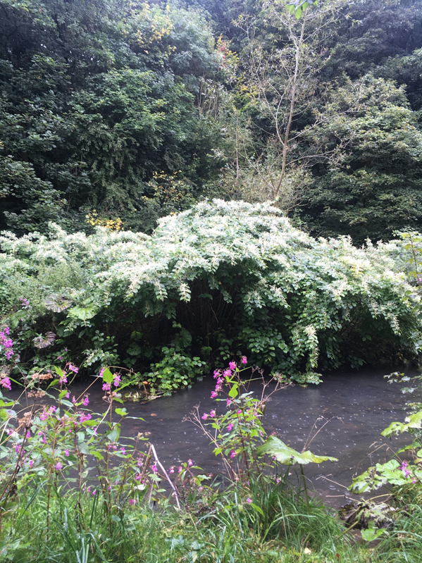
Why is Japanese knotweed a problem?
They out-compete our native flora
for light, space and nutrients
They can reduce the light and
heat reaching lower-growing plants
They alter rates of nutrient cycling,
or (in freshwater habitats) cause large
changes in the amount of oxygen
Available
It causes structural issues within the built environment
Notes:
Such damage can be irreversible and destroy many of our national natural treasures. In fact, 30% of the UK's Important Plant Areas have been found to have invasive species in them The ecological impacts after sites have been cleared can be far reaching - 30 years after Rhododendron cleared land is has not reverted back

Slide 7
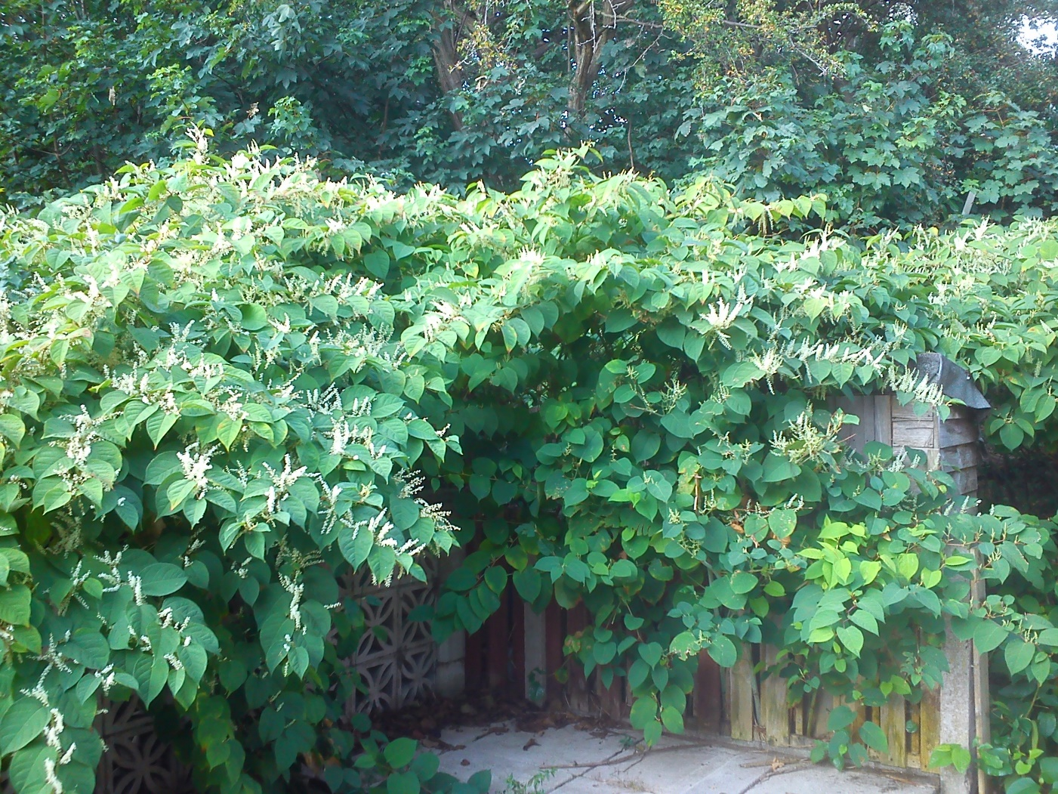
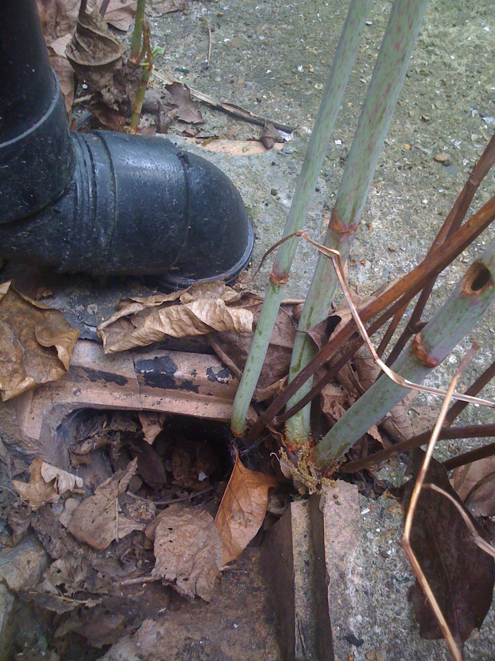
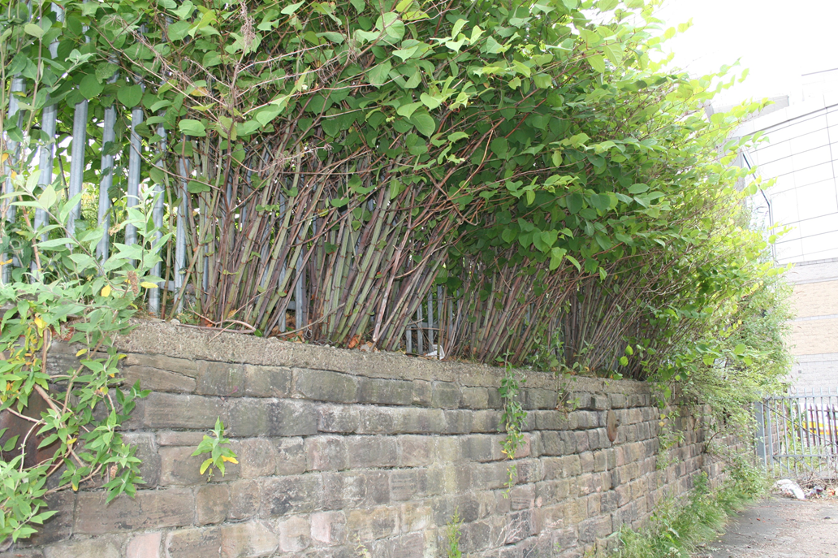
The Problem!

Slide 8
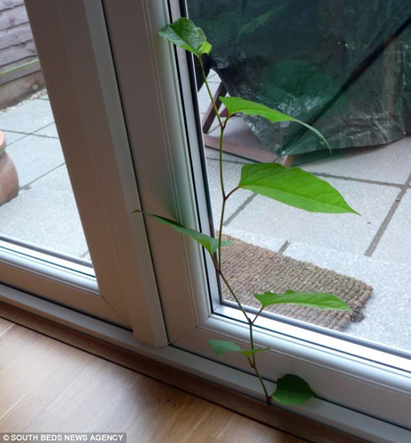
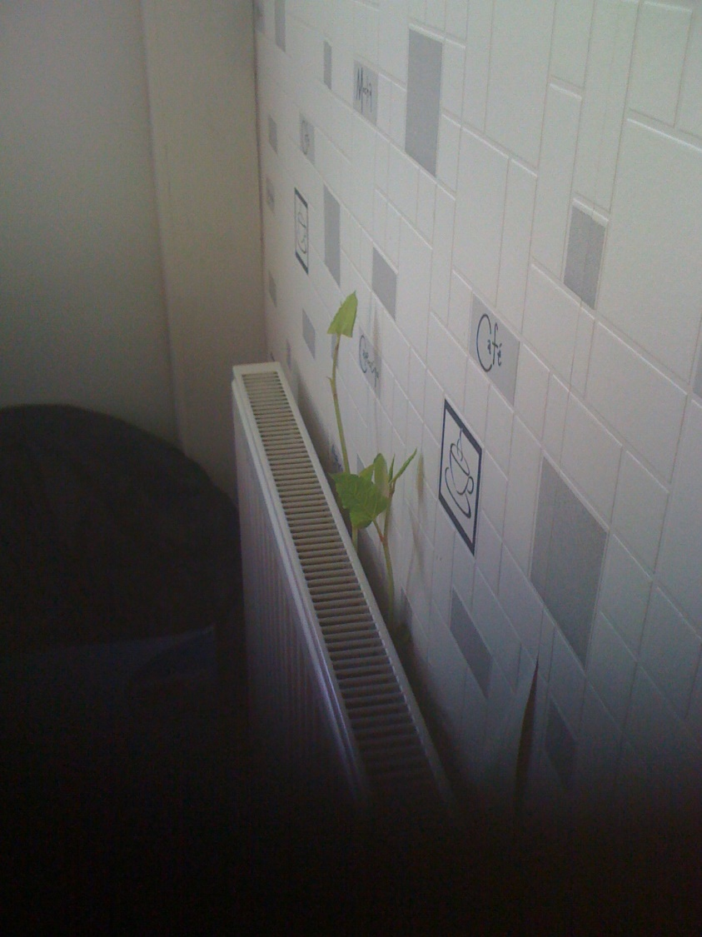
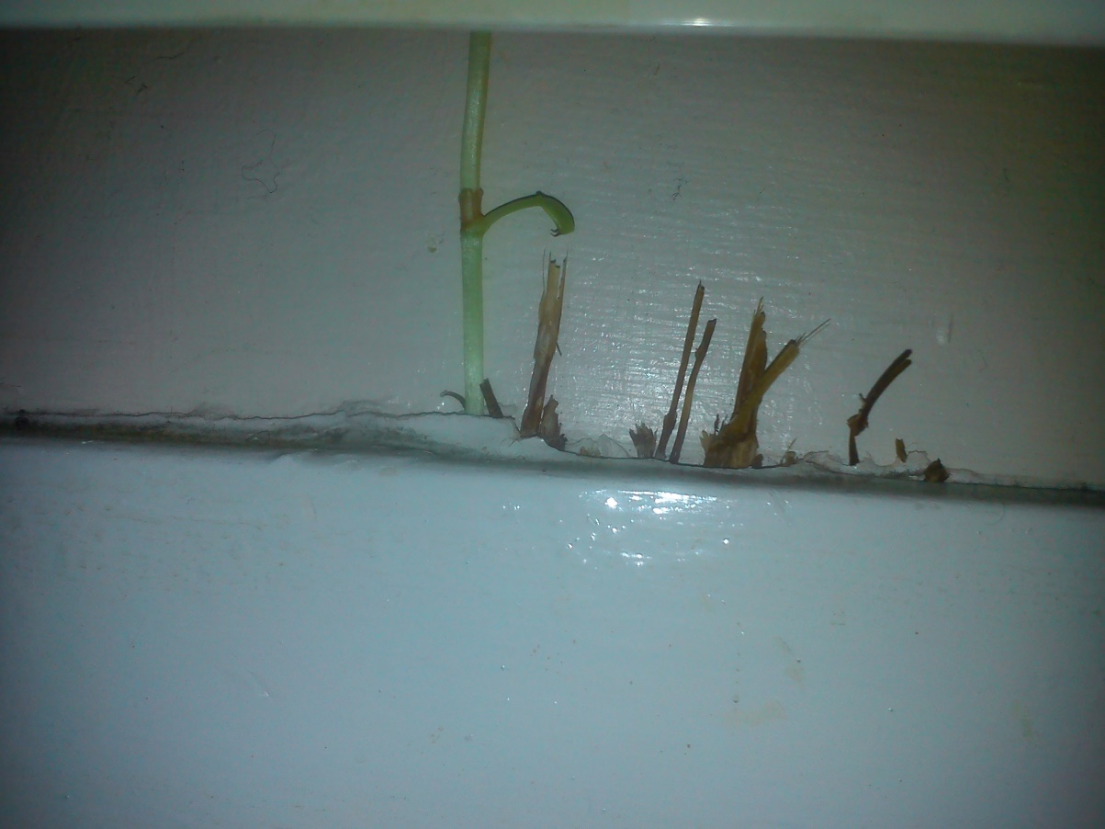
Structural Issues

Slide 9
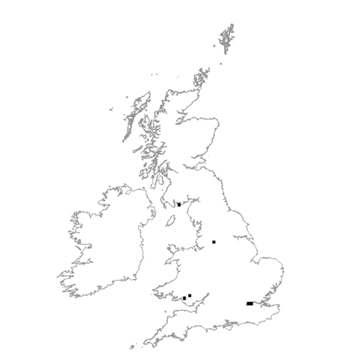
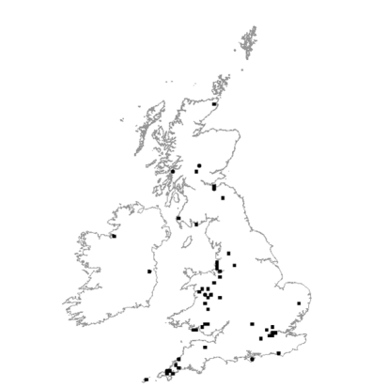
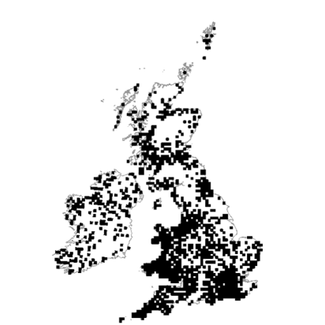
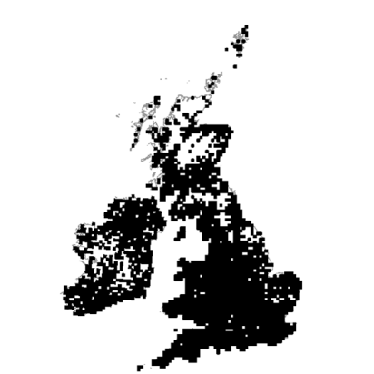
Distribution of Japanese Knotweed
1900
1940
1970
2012
*Source Cabi Science 2012
Notes:
Only the Orkney Isles are exempt Japanese Knotweed

Slide 10
The costs of invasive species
£1.7 Billion spent every year on controlling invasive species within UK (Defra 2010)
£70 Million on the Olympic site alone
(RHS Estimate)
€19.1 Billion per year in Europe.
(The Institute of European Environmental Policy 2009)
Notes:
Annual Costs – year in year out Government estimate it would cost £1.5 billion to rid the UK of JK
2016 the Government said that the cost would be £1.8 billion - £1.29 billion England, £0.25 billion Scotland & £0.13 billion Wales. Rabbits and JK responsible for the majority of the costs followed by wild oats and brown rats

Slide 11

Total Annual Costs of Japanese Knotweed
 | England | Wales | Scotland | GB
Local Authorities | £270,000 | £66,000 | £96,000 | £432,000
Research | £319,000 | £19,000 | £32,000 | £370,000
Railways | £1,726,000 | £100,000 | £174,000 | £2,000,000
Roadsides | £3,901,000 | £438,000 | £757,000 | £5,096,000
Riparian | £3,444,000 | £469,000 | £1,724,000 | £5,637,000
House devaluation | £963,000 | £56,000 | £97,000 | £1,116,000
Development | £141,358,000 | £7,644,000 | £1,508,000 | £150,510,000
Householders | £383,000 | £23,000 | £42,000 | £448,000
TOTAL | £152,364,000 | £8,815,000 | £4,430,000 | £165,609,000
The Economic cost of Invasive Non-Native Species on Great Britain
Defra, Nov 2010

Slide 12
Legislation
Wildlife and Countryside Act 1981.
Environmental Protection Act 1990
Controlled Waste (Registration and seizure of vehicles) Regulations 1991.
Environmental Protection (Duty of Care) Regulations 1991.
Hazardous Waste Regulations 2005.
Waste Management Licensing Regulations 1994.
Civil Actions.
Criminal Law introduced October 2014
Notes:
Under the Wildlife and Countryside act 1981, the law states that it is the legal responsibility of the landowners and developers to ensure that Japanese Knotweed is safely eradicated from contaminated land. Failure to do so in a controlled manner and by a competent specialist will result in prosecution.
Environmental Protection Act 1990 JK is classified as a ‘controlled waste’ and as such is required to be treated under the ‘duty of care’ requirements stipulated under the Environmental Protection Act of 1990. This act states that ‘controlled waste’ should be disposed of by qualified contractors within licensed disposal sites

Slide 14
Anti- Social, Behaviour, Crime and Policing Act 2014: Anti-social behaviour powers. Revised January 2021
Clear guidance to empowered regulators.
Community Protection Orders enforceable by:-
  Council Officers
  Police Officers
  Social landlords (if designated by the council).
Focus on mediation and resolution.
Large Fines and penalties for non compliance.

Slide 15
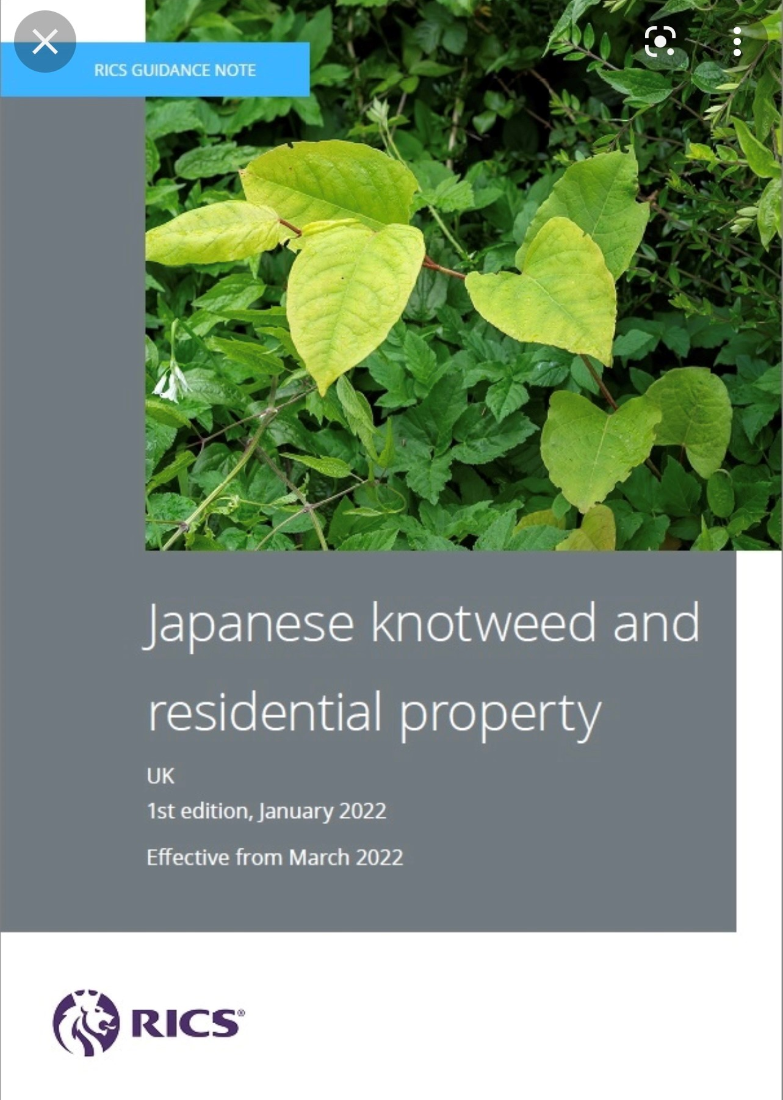
RICS Guidelines

Slide 16
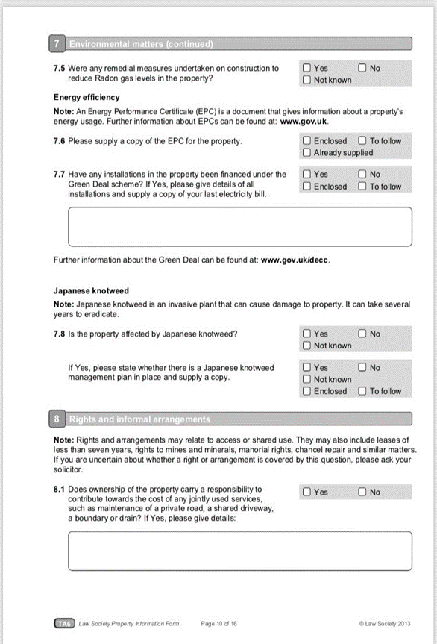
Notes:
Home owners wishing to sell their property must fill out a property information form, called a TA6, declaring whether the property or garden is, or has been, affected by the invasive weed.
But developers and builders are not obliged to complete the form, which was introduced in 2013

Slide 17
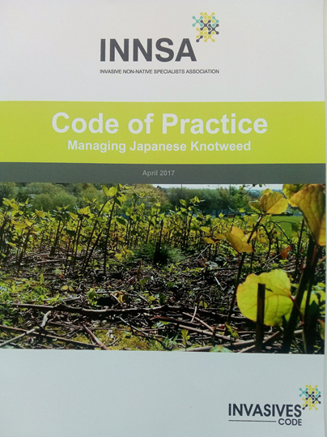

Notes:
The original code of practice was wrote by Trevor Renals of EA in 2001. INNSA Code of practice foreword by Trevor & co-authored by INNSA alongside JKC . The Code contains the most up-to-date advice for those who may encounter, or need to manage, land that is susceptible to or infested with the invasive plant. users can avoid excessive and recurring costs, physical damage to man-man structures, harming the environment and even potential legal action.

