Slide 1
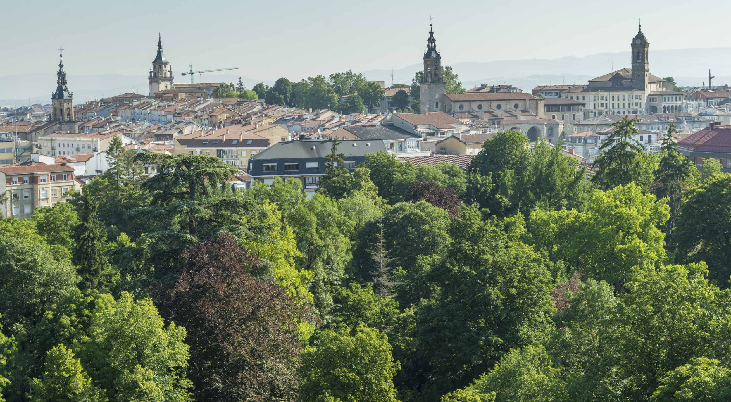
Brownfield remediation in a Green City:
The case of Vitoria-Gasteiz
Juan Vilela, Forest Engineer and Landscape Architect
Green Infrastructure and Territory
Center for Environmental Studies (CEA, Vitoria-Gasteiz, Spain)

Slide 2
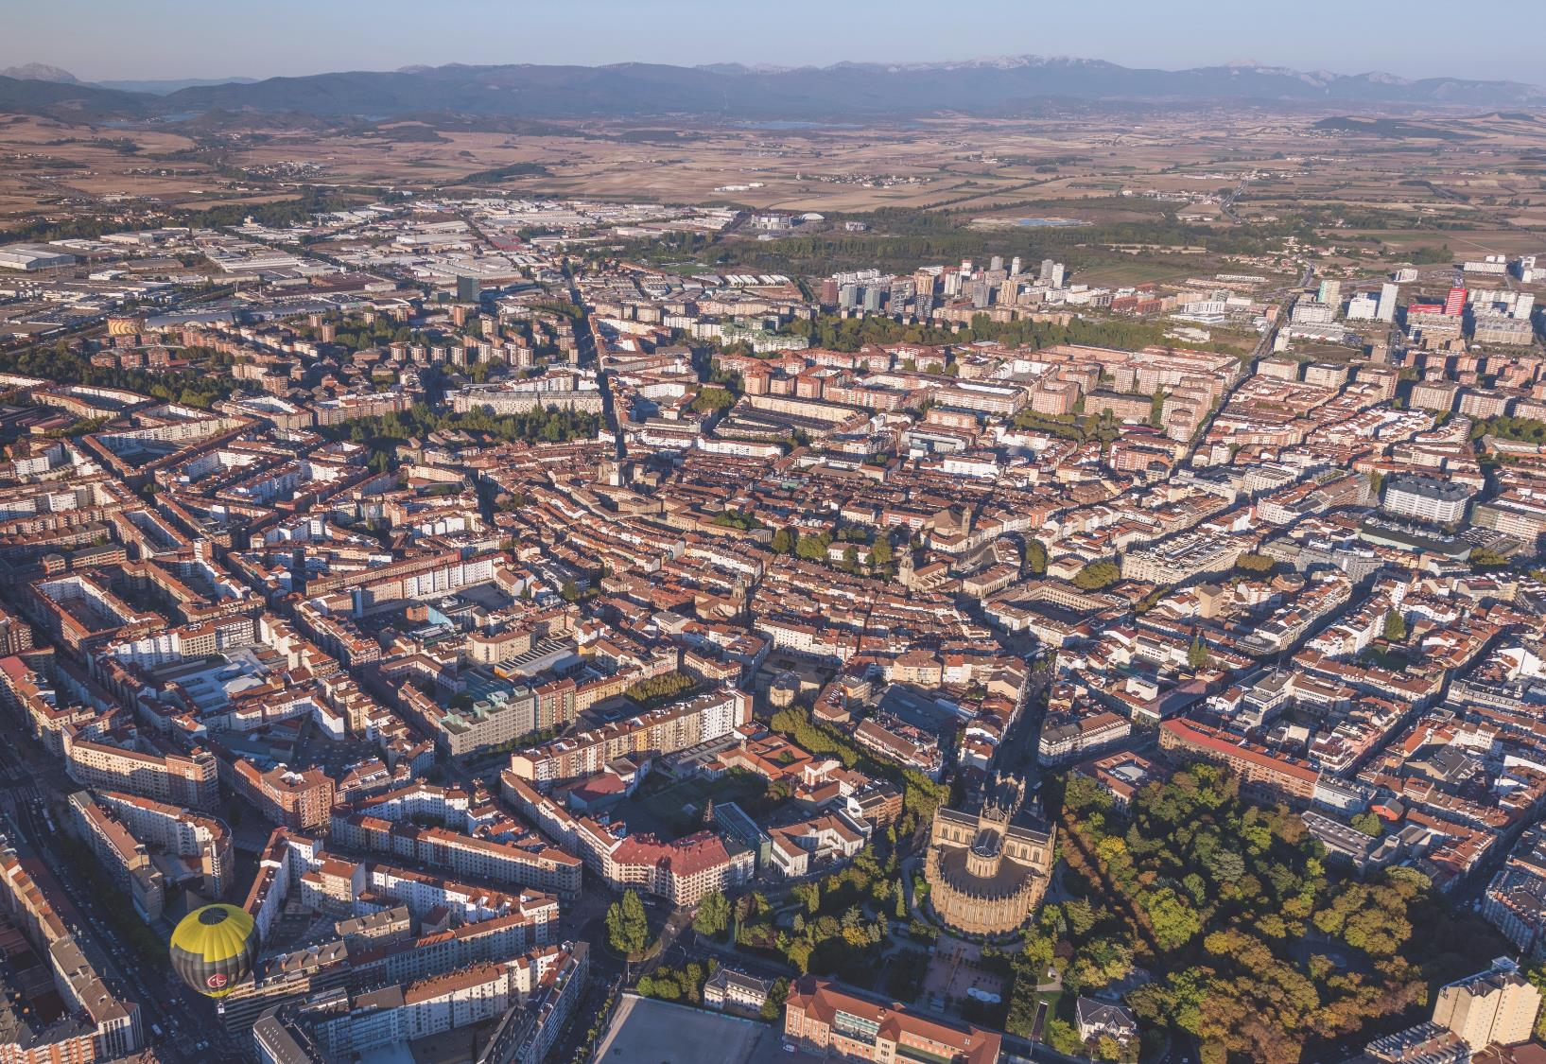
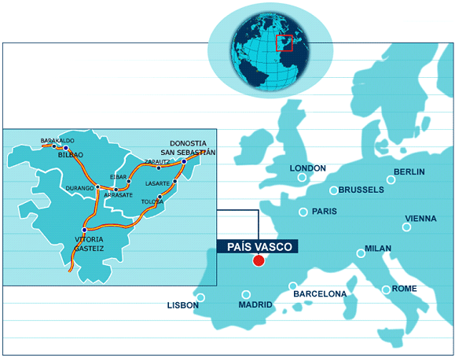
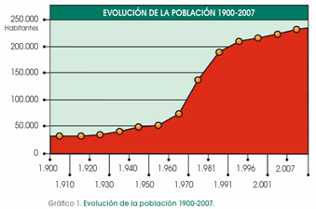
Vitoria-Gasteiz: a city connected to nature and landscape
Basque Country capital
246,042 inhabitants
276.81 km².
European Green Capital 2012

Slide 3
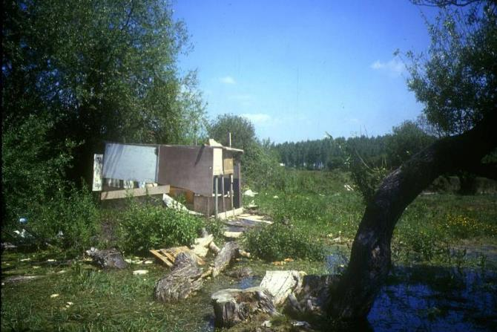
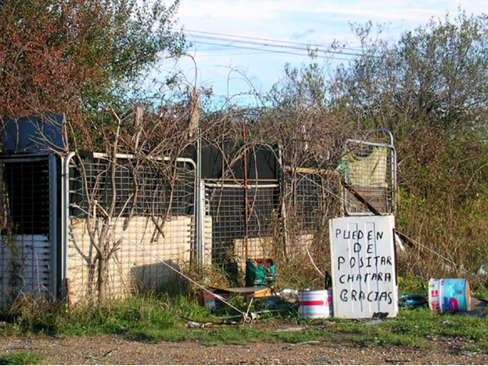
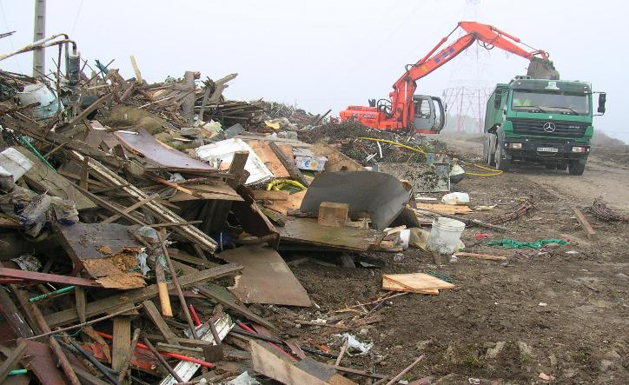
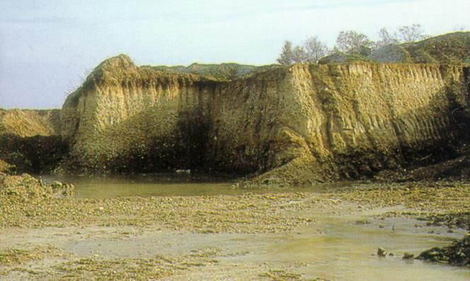
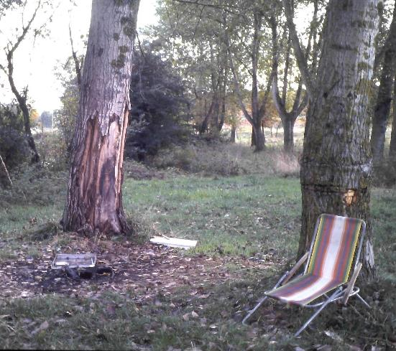
1990s: facing environmental problems
….shifting from hard solutions to a new vision inspired by nature

Slide 4
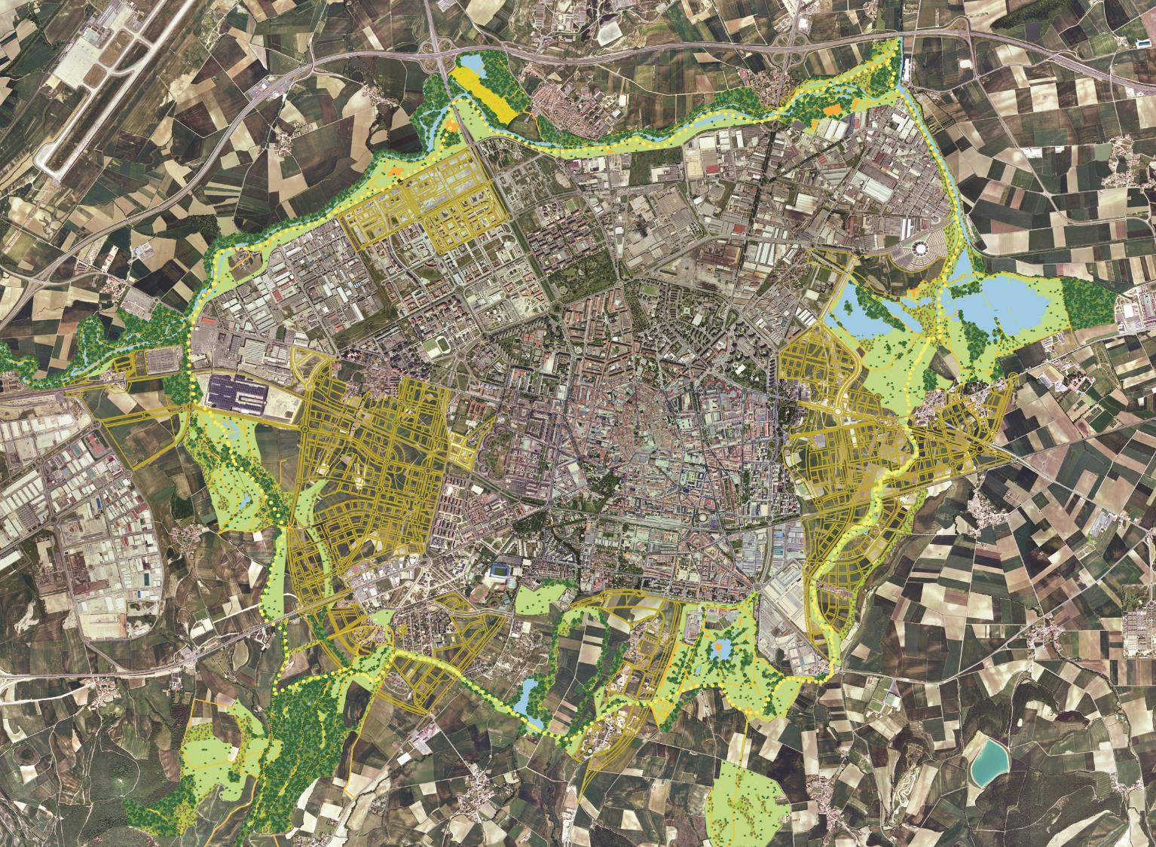
Vitoria-Gasteiz´s Green Belt (1990´s)
  To provide a solution for the degraded peripheral spaces (brownfields from the industrial-urban growth)
  To promote the conservation of existing biodiversity and natural areas
  To meet the public demand for leisure spaces and reduce pressure outdoors
  To offer educational and tourist resources involving the communities in environmental conservation.
  To contain the urban growth of the city within limits given.

Slide 5
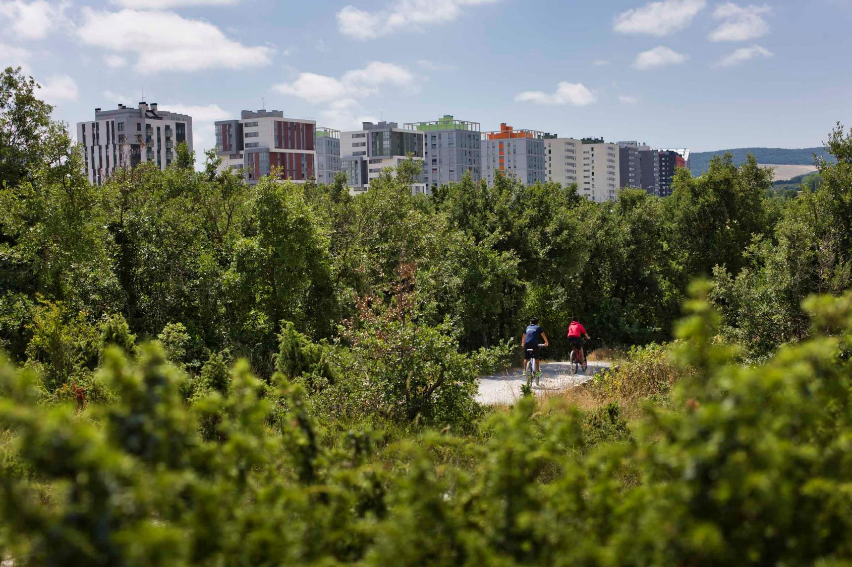
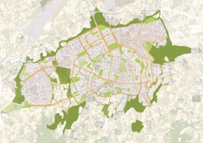

PROJECT 1. ZABALGANA FOREST: GRAVEL PIT RESTORATION
Improving aesthetic values
Daily city-nature conection
Thermal regulation
Reduction of urban heat island effect
Safe and accesible
High biodiversity
Increasing the
carbon sink effect
After the remodelling and ecological and landscape improvements carried out, Zabalgana Park is currently a forest of high natural value, right beside the Zabalgana Neighbourhood.
Sports and leisure
Contemplation and spiritual well-being
ZABALGANA FOREST

Slide 6
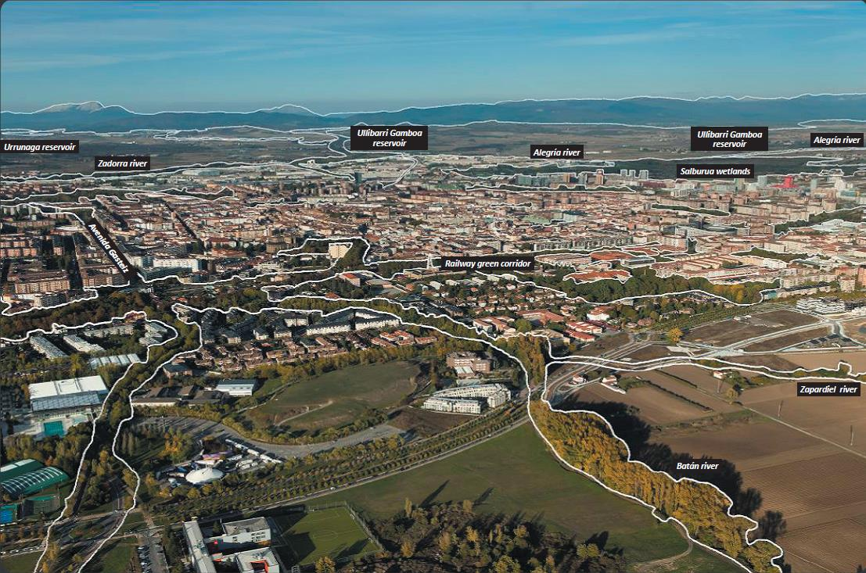

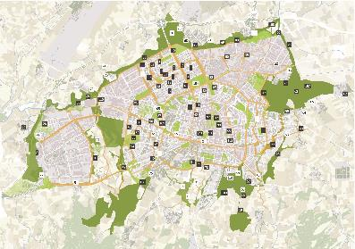
Vitoria-Gasteiz´s Green Infrastructure System (2014)
An extensive green "multifunctional" mesh that impregnates the entire city.
New designs for new needs by using NBS (Nature Based Solutions)
Pilot project approach: 111 projects

Slide 7
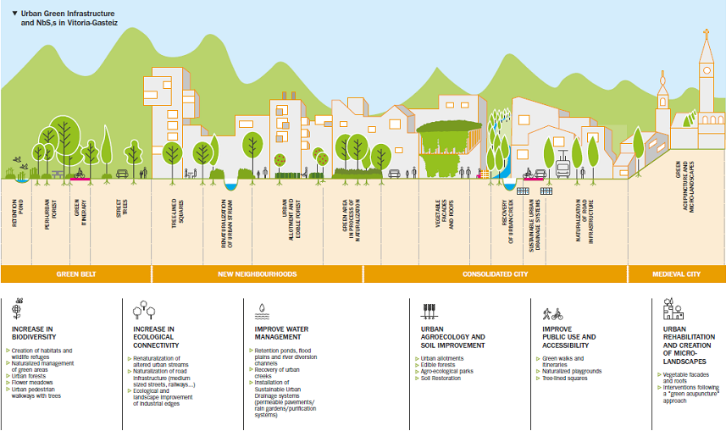

Slide 8
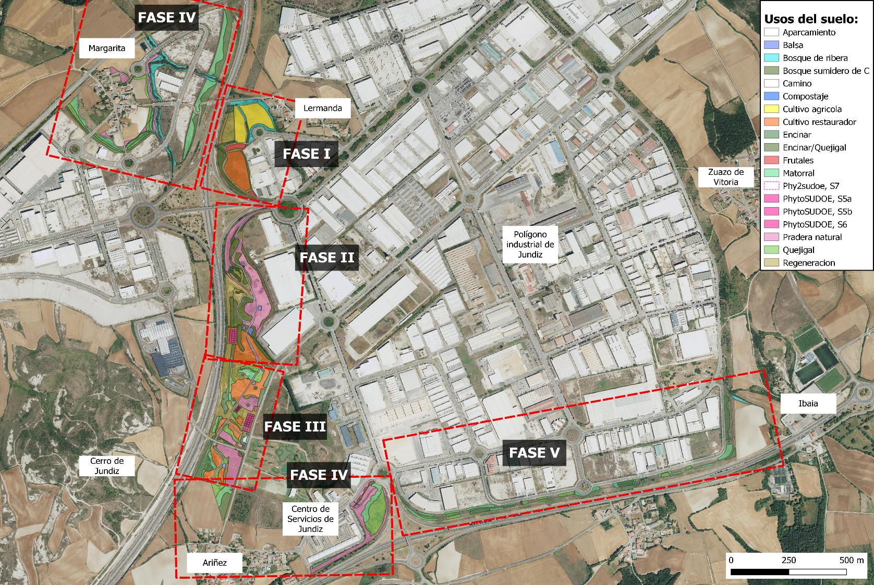
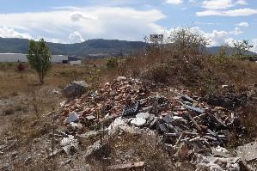
PROJECT 2. JUNDIZ PARK: INDUSTRIAL BROWNFIELDS AND POLLUTED SITES RESTORATION
Abandoned Industrial public lands used for illegal landfills were gradually restored to create a green corridor. Organic amendments and agroforestry plantations were applied along with oher phytorremediation techniques.
JUNDIZ PARK

Slide 9
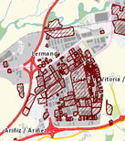
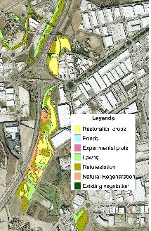
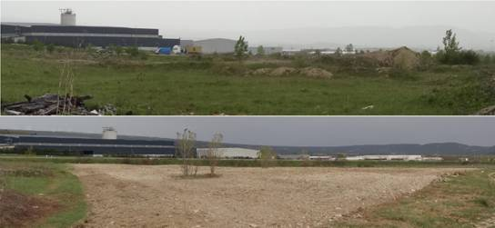



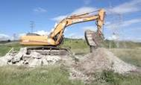
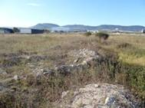
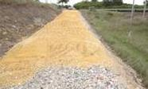
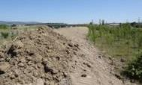
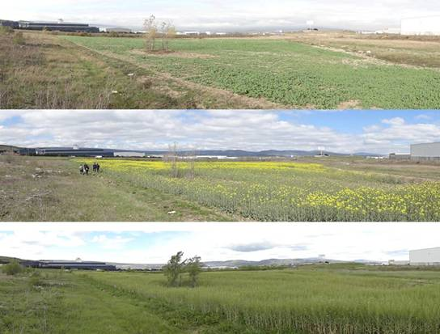
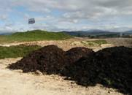
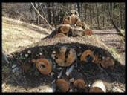
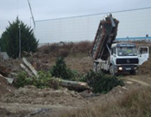
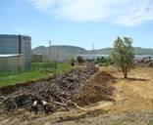
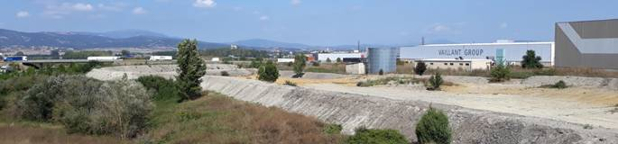
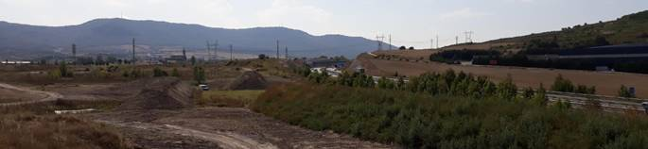
Polluted soils inventory
Jundiz Park Green Corridor
Introducing soil health concept
reuse of inert materials
organic matter addition
crops rotation for soil health restoration

Slide 10
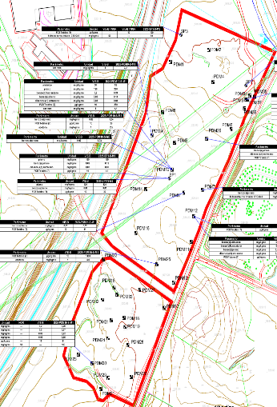
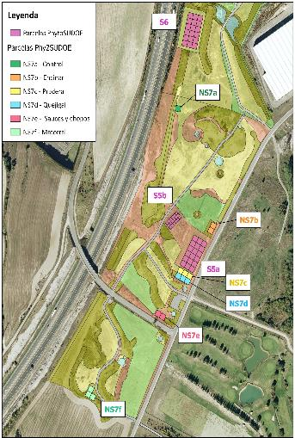
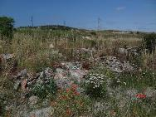
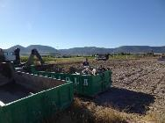
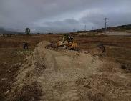
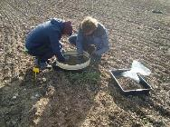
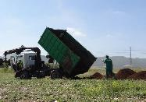
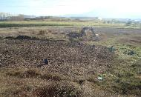
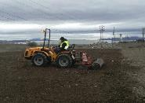
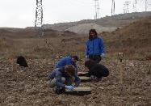
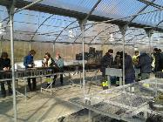
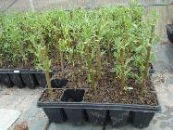
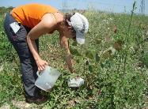
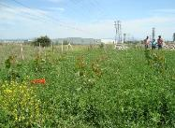
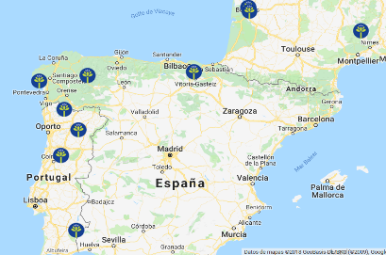
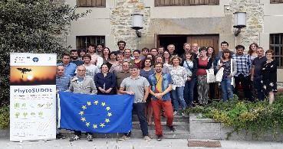
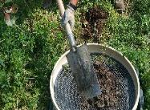
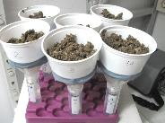
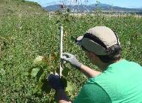
www.phytosudoe.eu
Control
Holm Oak forest
Meadow
Gall Oak forest
Ponds
Willow/Poplar
Scrub
polluted sites
experimental plots
reports
Phytoremediation techniques
previous state
residues removal
land works
pollution analysis
organic amendment
site marking
site preparation
soil anaylisys
cuttings preparation
willows
inoculation
planting
PhytoSUDOE: polluted soils phytoremediation across southwest Europe
Consortium: Universities + Research Centers + Public and private soil owners
Years: PhytoSudoe 2018-2020. Ph2Sudoe: 2021-2024
vegetation analysis
soil anaylisis
biodiversity

Slide 11





Phase VI
Phase V

Slide 12





PROJECT 3. SCHOOLYARD NATURALIZATION: PARTICIPATORY PROCESS FOR PRIMARY SCHOOLS GREENING
Outdoor activities
Play and learning with nature
Thermal regulation, shadow
Increase Biodiversity
The Schoolyard Naturalization Programme has transformed 14 playgrounds through parcitipatory processes with the educational community
SOIL DEVAPING and decompaction is one of the first steps to green these areas.
Aesthetic enhancement
Connection with natural cycles
Soil permeability
TXAGORRITXU SCHOOLYARD

Slide 13



Long term experimental site
Quercus faginea soil forest site
(Gamiz, Spain)
PROJECT 4. HOLISOILS PROJECT: FOREST SOIL MANAGEMENT FOR CLIMATE CHANGE ADAPTATION
In collaboration with the Basque Centre for Climate Change the Gamiz Site has been stablished as a long term forest soil experimental site
To spread shreded prunnings (slash) over the soill improved soil functions and C storage.
www.holisoils.eu

Slide 14





PROJECT 5. LARRAGORRI PARK: POLLUTED SITE RESTORATION FOR FLODDING CONTROL
Formed gravel pits later filled with construction and demolition residues remain in the south of the city, over a risk flodding area.
Soil are polluted and private, making a challenge the site transformation into a park.
LASARTE RETENTION POND

Slide 15










www.lurzain.eus
PROJECT 6. SOIL CONSERVATION CITIZEN SCIENE PROGRAM: SOIL MONITORING WITH THE COMMUNITY
Participatory science program for soil monitoring and awareness.
Since 2018 more than 300 plots have been evaluated
Next challenge is to get more involvement from the educational community.

Slide 16

SOIL HEATH MONITORING
Basic soil health parameters
Basal respiration (microbial activity) and Induced respiration (potential microbial biomass)
Functional microbial diversity through Community-level physiological profiles Biolog Ecoplates (metabolic diversity of microbial communities) and Enzimatic activities (e.g. dehydrogenase, β-glucosidase, urease, arylsulfatase and acid and alkaline phosphatase activities).
Soil phytotoxicity tests
Advanced soil health parameters
Structural diversity of soil microbial communities through DNA metabarcoding – Next Generation Sequencing
PROJECT 7. URSOILL: URBAN SOILS LIVING LAB
3. Naturalized schoolyards.
Soil depaving monitoring in naturalizad scholyards.
1. Lermanda site.
Native fruit tree orchard and crops to improve soil health.
In the context of the European Soil Mission this project sets up 7 actions for improving urban soils health.
From soil depavimentation to soil bioremeditaion actiions, soil monitoring with citizen sicene will involve end-users and promote soil literacy in the community.
4. Soil literacy promotion.
Soil literacy promotion with citizen science programs in the educational community.
2. Arkatxa site.
Old landfill restoration through soil amendments and bioremediation techniques.

Slide 17

Thank you!
Email: jvilela@vitoria-gasteiz.org
www.vitoria-gasteiz.org/greeninfrastructure

